Slide 1
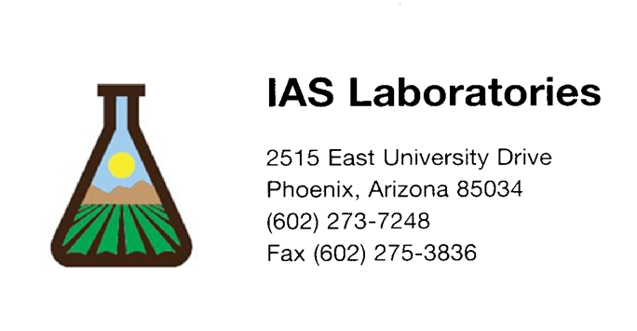
Reduction of Common Ground Pests

Slide 2
Sheri McLane
Owner and Agronomist (10 years)
Certified Crop Advisor (CCA license)
BA in Environmental Science, Chemistry and Biology (University of San Diego)
Masters of Agronomy (Iowa State University)
18 years in the Chemistry and Science Field
15 years of that in Agronomy with Arizona Agriculture

Slide 3
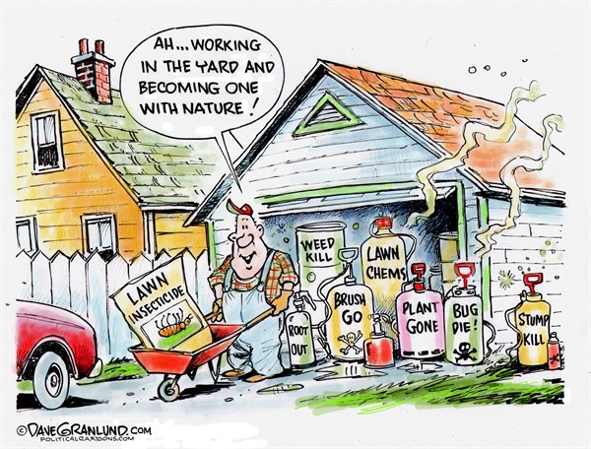

Slide 4
Integrated Pest Management (IPM)
Definition:
Reduction of plant loss using optimum mixes of pest control techniques
Result:
*Increase plant productivity
*Environmental sustainability
*Cost effectiveness

Slide 5
Integrated Pest Management (IPM)
Four Categories
Prevention
Avoidance
Monitoring
Suppression

Slide 6
Prevention
Goal: Prevent the establishment of the pest
Import pest free compost/soil
Pest free seeds and transplants
Prevent weeds
Schedule irrigation to prevent disease
Clean equipment
Healthy soil

Slide 7
Prevention

Slide 8
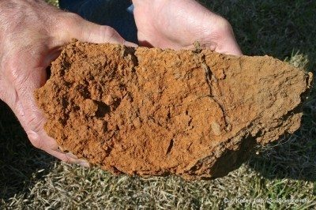
Know Your Soil

Slide 9
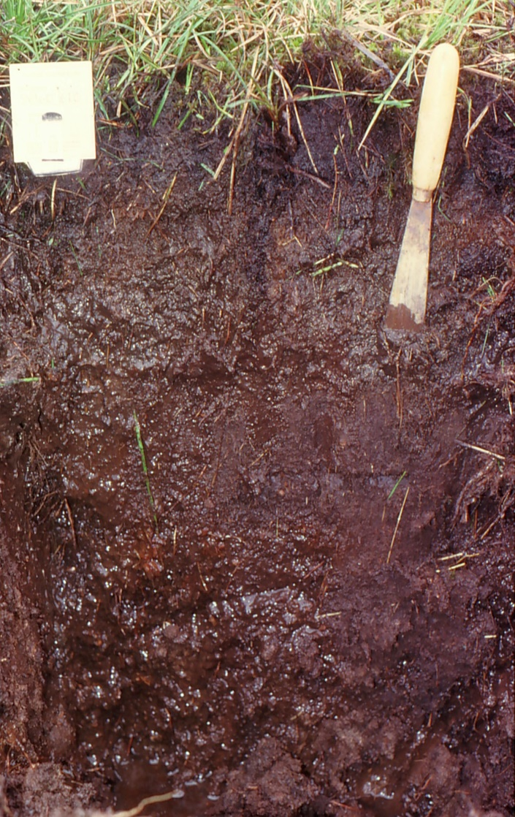
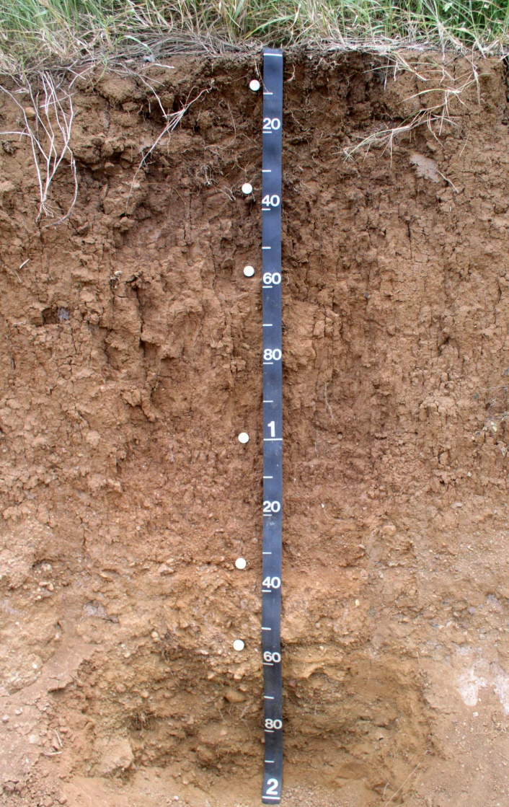
Soil Drainage

Slide 10
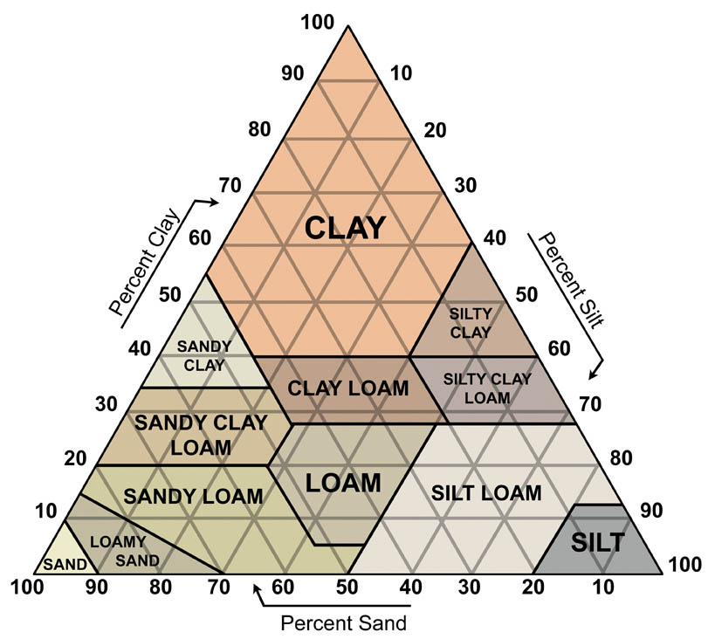

Slide 11

Prevention – Healthy Soil
Get a Soil Agronomy Analysis!!!!!
pH and salinity
Major Nutrients
Secondary Nutrients
Micronutrients
Agronomic recommendation

Slide 12
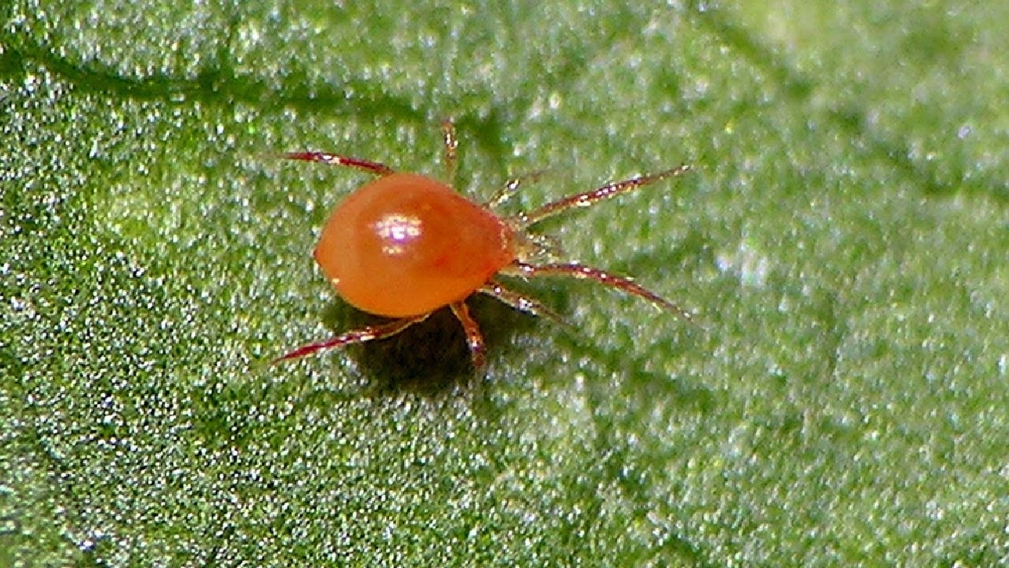
Nitrogen
Adequate
Speeds up growth
Fuller root system
Increase in chlorophyll
Increase water efficiency
Thicker turf
Too Much
Easily injured
Weaker Stems
Increased logging
Prone to many insect and disease
Slows maturity
Increase water usage

Slide 13
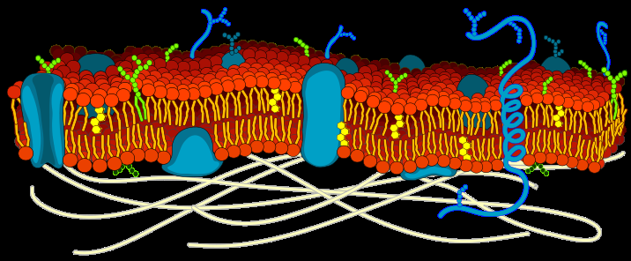
Phosphorus
Adequate
Genetic material
Energy cycle
Cell membrane
Root Growth
Increase water efficiency
Plant defense compounds
Deficient
Stunting/smaller leaves
Reduce foliage
Purple/red tint
Delayed maturity

Slide 14
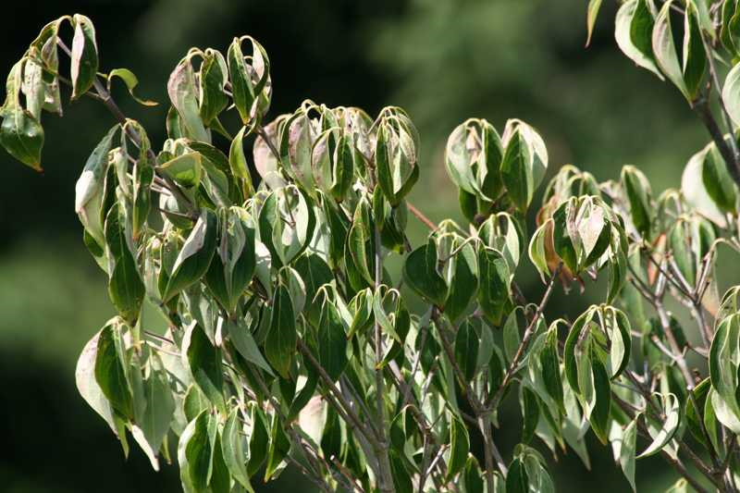
Potassium
Adequate
Control osmotic pressure within plant
Cell wall formation
Plant defense compounds
Resist disease and pests
Better resist ware and tear
Deficient
Water stressed plant
Too much nitrogen

Slide 15
Avoidance
Definition: Practiced when pest populations exist in a field/landscape but the impact of the pest on the plants can be avoided through cultural practices

Slide 16
Cultural Practices
Rotate plants
Plant Arizona appropriate plants
Cultivars with genetic resistance to pests
Different maturity dates
Trap plants (sacrificial plants)
Companion plants

Slide 17
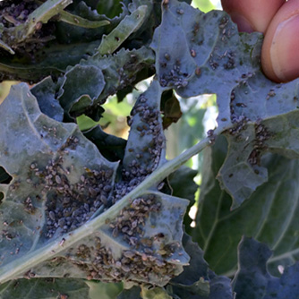
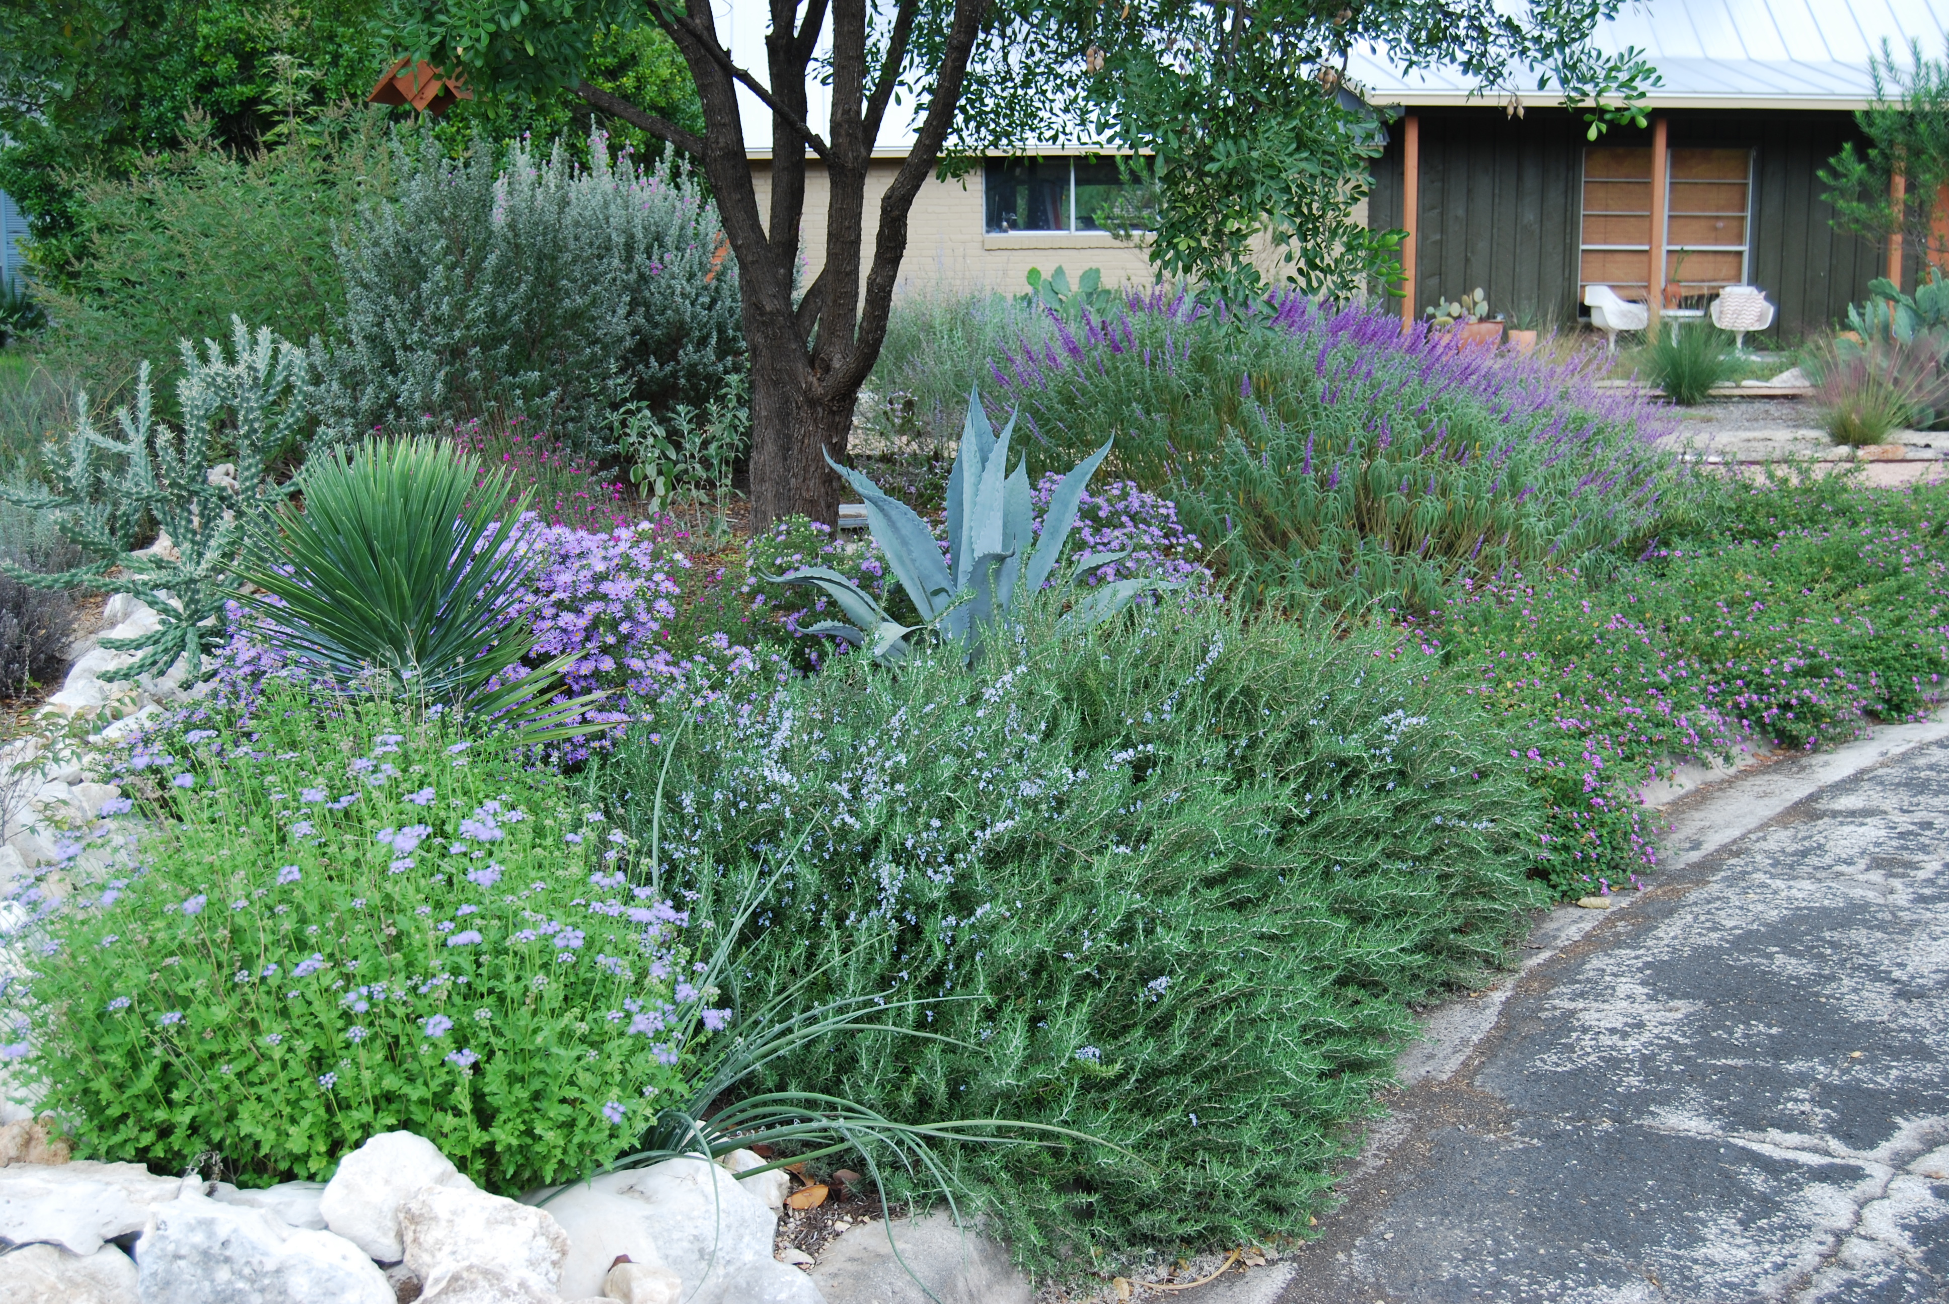
Trap Plants vs Companion Plants

Slide 18
Monitoring
There Here!!!!!!

Slide 19
Monitoring
Proper identification of pests & beneficial insects
      Survey and scouting
      Trapping
      Weather monitoring
Good Record Keeping !!!!

Slide 20
Monitoring
Understand your enemies and your armies
Life cycle
Feeding habits
Preferred habitat
Economic Thresholds
Suppression Actions

Slide 21
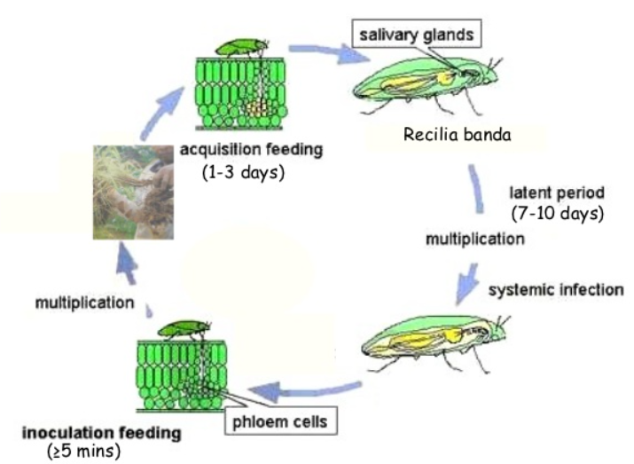
Leaf Hopper
Eggs overwinter
Hatch in spring/warm
Nymphs feed 2 months
Adults lay eggs every 2-4 weeks
Increase population damp/humid
Best Results: spray at nymph stage

Slide 22
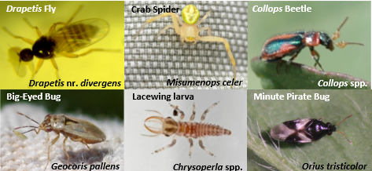
Beneficial Insects (Predators)
Photo by: Arizona Pest Management Center Univer
University of Arizona

Slide 23
https://ybertaud9.files.wordpress.com/2013/12/beneficial-insects.jpg

Slide 24
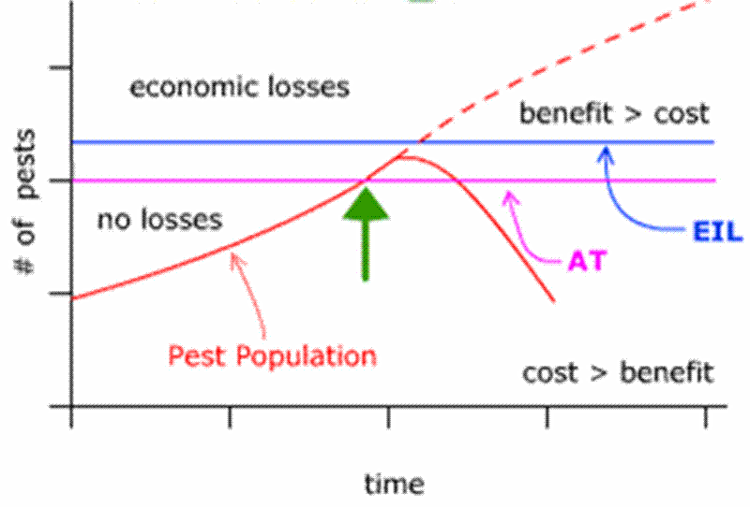
Economic Thresholds – Old School

Slide 25
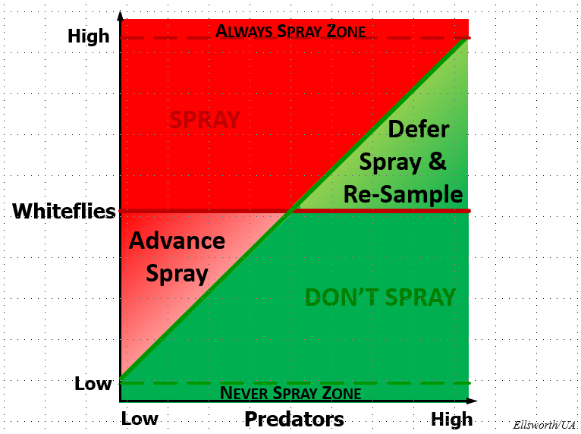
Economic Thresholds - Modern

Slide 26
Suppression
Physical
Biological Control
Add Chemistries - Insecticides

Slide 27
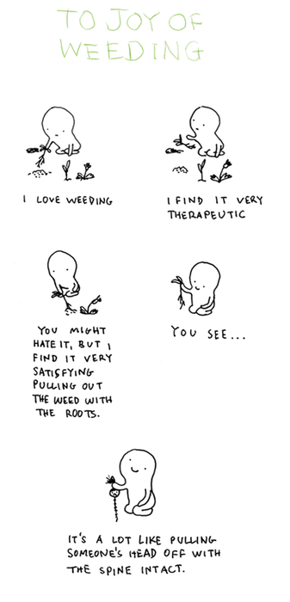
Physical Suppression
Removing weeds
Replacing infected trap plants
Temperature management

Slide 28
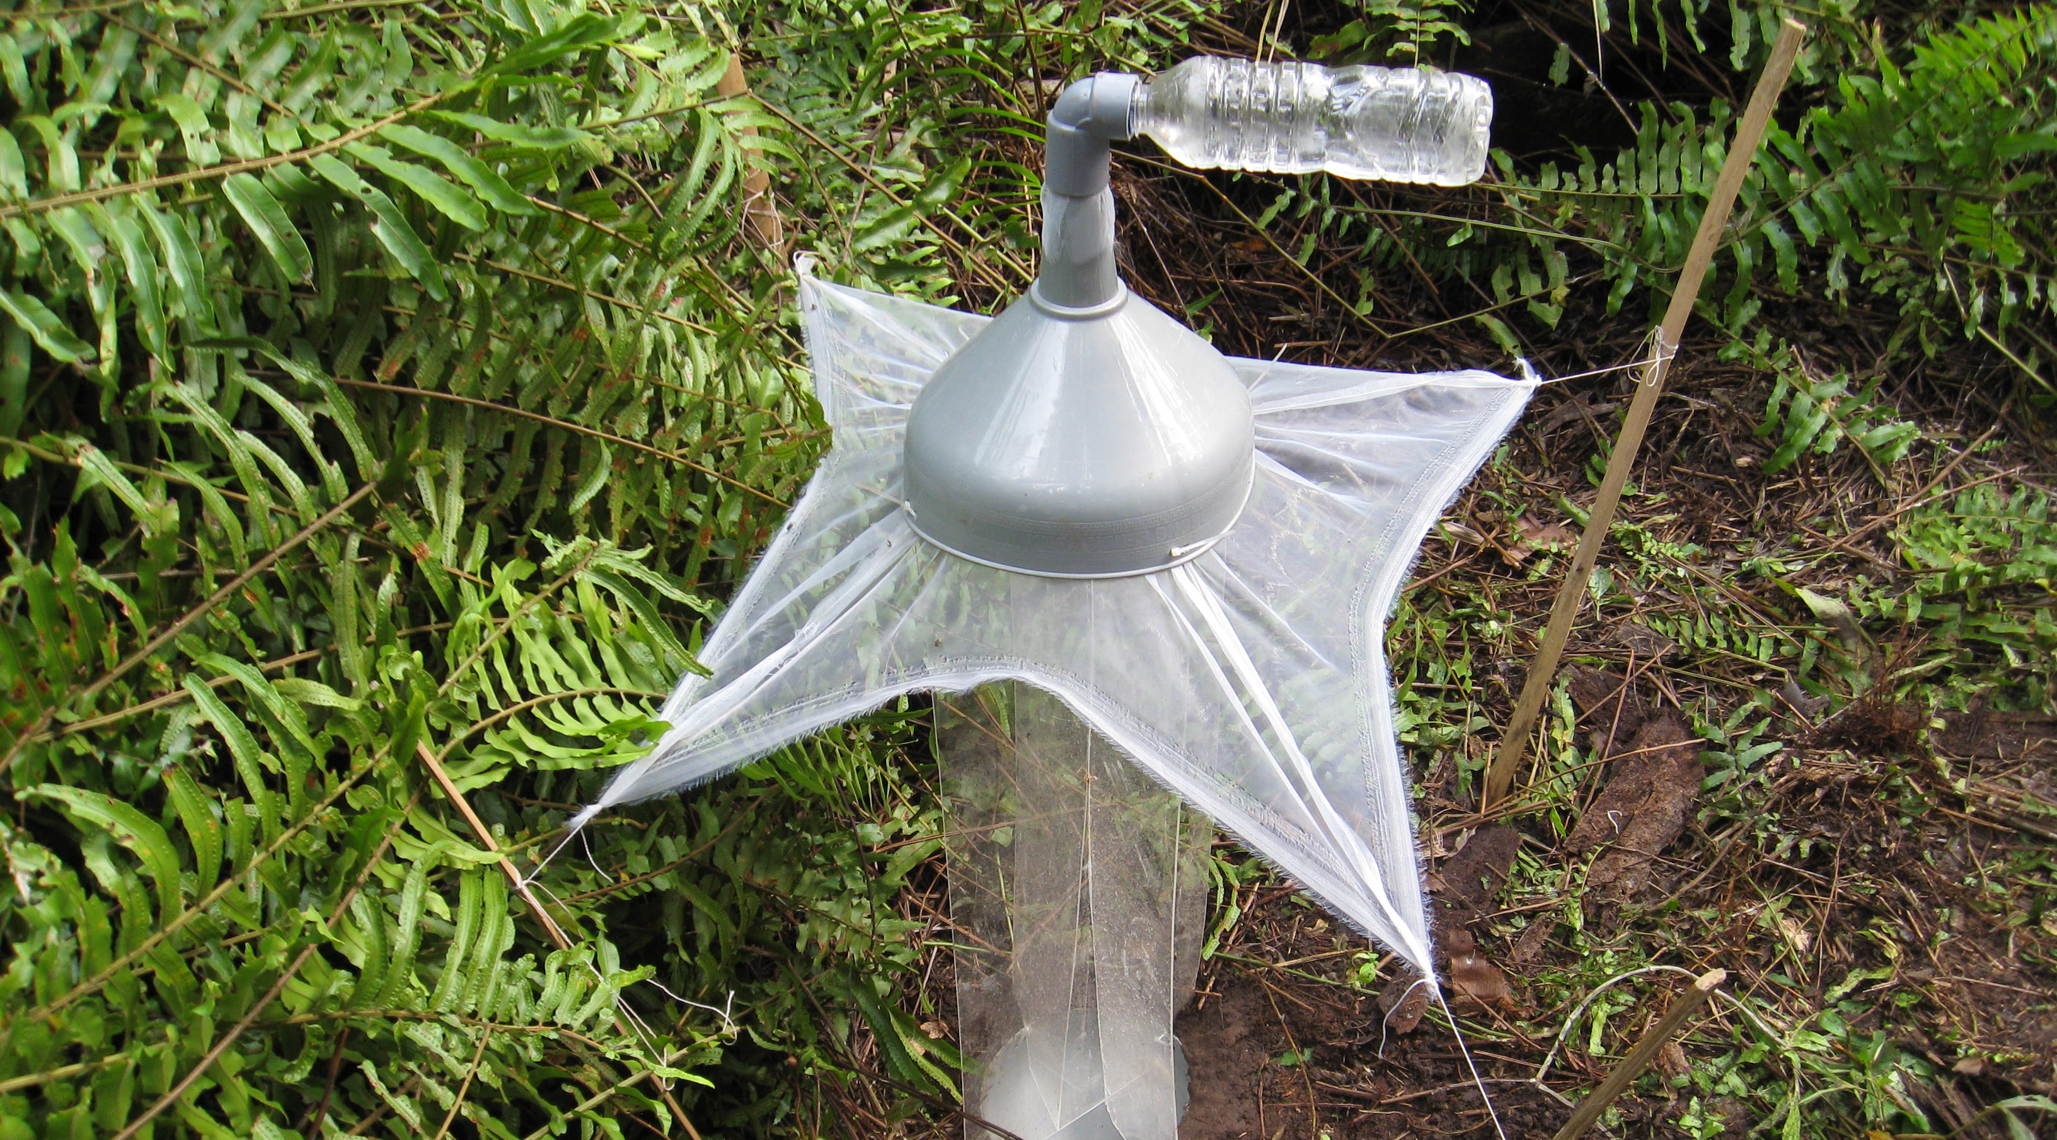
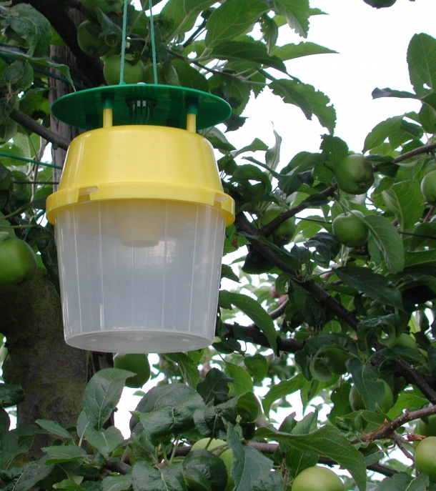
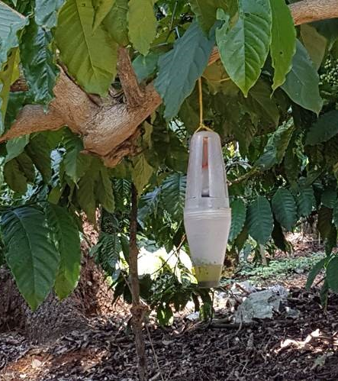
Biological Control
Apply beneficial pests
Apply pheromones
Disrupt the life cycle

Slide 29
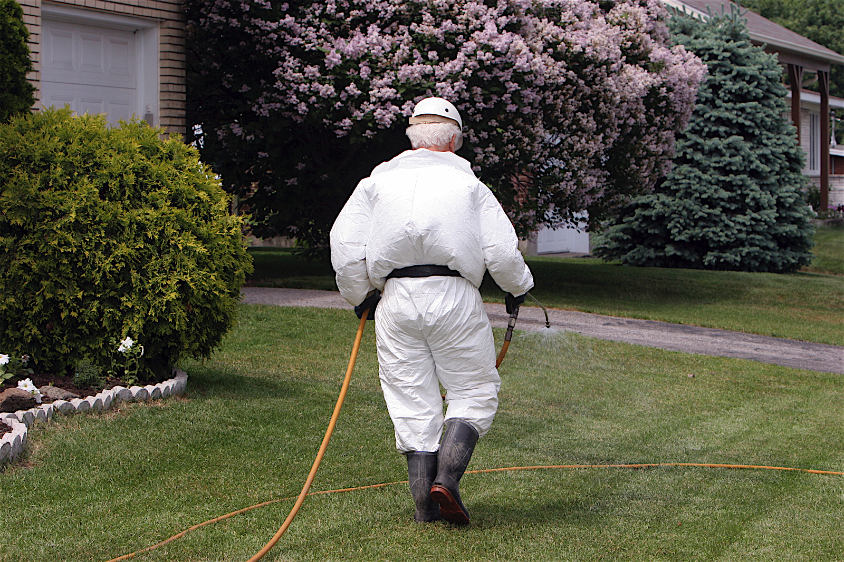
Chemical Suppression

Slide 30
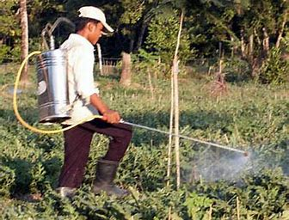
Chemical Application
Choose selective chemistries
Practice precision application
Use multiple modes of action
Calibrate machinery first
Follow the label
Avoid drift

Slide 31


Thank you, from our family

