Slide 1


SHADE
Marriott Desert Ridge Resort, Phoenix, AZ
Aug 30, 2019
Local Research:
Economic Studies of
Green Infrastructure
In Tucson
Irene Ogata, PLA, CPM, ASLA, AzAPA
Urban Landscape Manager
Public Information & Conservation Office
Tucson Water, City of Tucson

Slide 2



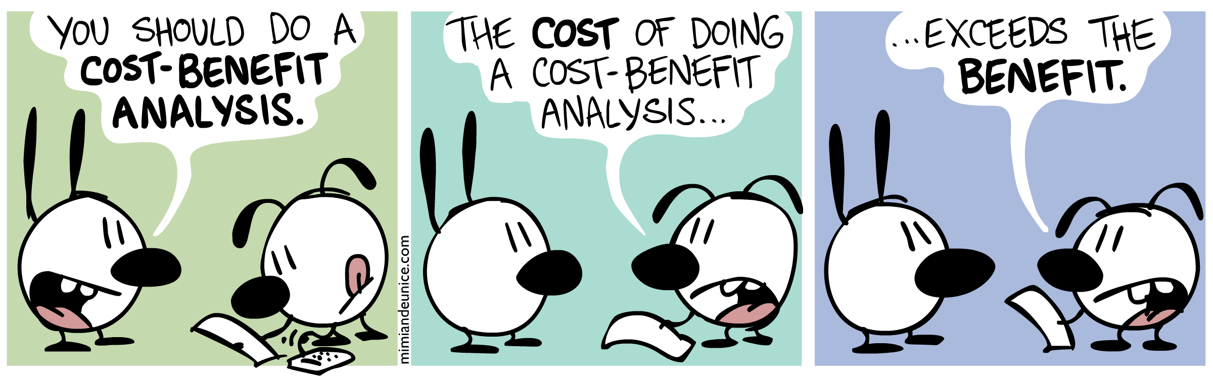
Analyzing Economic Benefits of Green Infrastructure
A Cost-Benefit Analysis

Slide 3
Analyzing Economic Benefits of Green Infrastructure
A Cost-Benefit Analysis

Slide 4
Analyzing Economic Benefits of Green Infrastructure
A Cost-Benefit Analysis

Slide 5
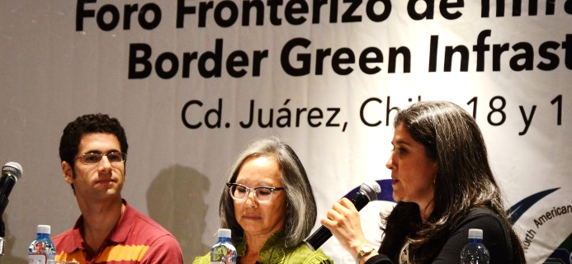
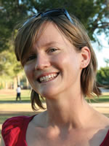




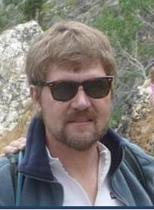
Epiphany – AH HA Moment of Green Infrastructure
2014 BECC/COCEF Forum
2013 ISC Leadership Academy
Adaptive Water Resource Management & Infrastructure, Philadelphia, PA 2013
Mead Mier
PAG
Sam Credio
COT DOT
Jean McClain
UA WRRC
Janet Clements
Managing Economist
Stratus Consulting
Triple Bottom Line
Analysis of Philadelphia CSO Program
Evan Canfield
PC RFCD
Irene Ogata
COT OIP

Slide 6

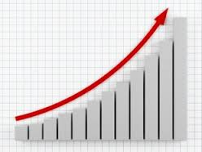
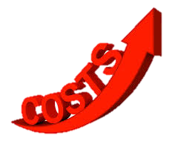
Analyzing Economic Benefits of Green Infrastructure
Managing stormwater infrastructure : At What
?
?
Gray Infrastructure:
Escalating needs
Deferred Maintenance
Growing communities
Climate Change
resulting in rising

Slide 7

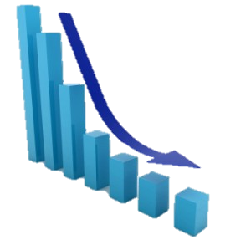
Analyzing Economic Benefits of Green Infrastructure
What We Want to Know

Slide 8
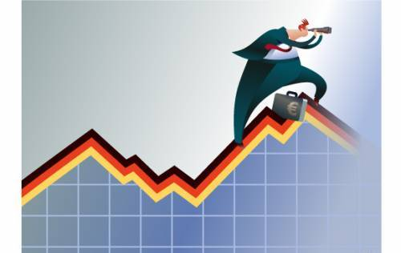
Analyzing Economic Benefits of Green Infrastructure
Does GI Pay For Itself?
A Bit Complicated
Function: why do an analysis
Evaluate alternatives
Does cost exceed benefits
(Private : Expense + Revenue)
Demonstrate range of benefit
(Public : Triple Bottom Line | more
than cash flow)

Slide 9
Analyzing Economic Benefits of Green Infrastructure
Does GI Pay For Itself?
A Bit Complicated
Function: why do an analysis
Evaluate alternatives
Does cost exceed benefits
(Private : Expense + Revenue)
Demonstrate range of benefit
(Public : Triple Bottom Line | more
than cash flow)
Metrics: Universal standards/site specific
Expense / benefit seeking
Net present value (NPV) of program
Net present value to owners
Net present value to stakeholders /
public
avoided costs
monetized social & environmental
benefits
life-cycle costs

Slide 10
Analyzing Economic Benefits of Green Infrastructure
Does GI Pay For Itself?
A Bit Complicated
Function: why do an analysis
Evaluate alternatives
Does cost exceed benefits
(Private : Expense + Revenue)
Demonstrate range of benefit
(Public : Triple Bottom Line | more
than cash flow)
Metrics: Universal standards/site specific
Expense / benefit seeking
Net present value (NPV) of program
Net present value to owners
Net present value to stakeholders /
public
avoided costs
monetized social & environmental
benefits
life-cycle costs
Type: methodology
Consultant
Stormwater software

Slide 11
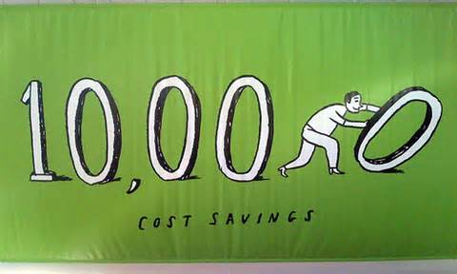

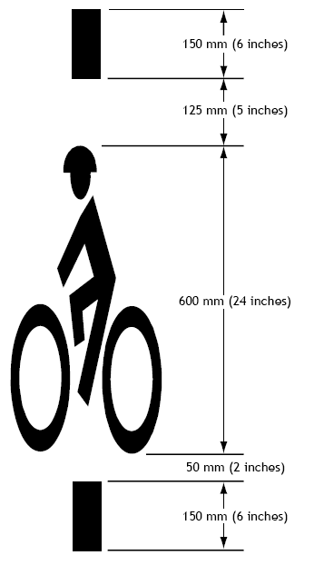
Analyzing Economic Benefits of Green Infrastructure
Green Infrastucture Benefit

Slide 12
Analyzing Economic Benefits of Green Infrastructure
Green Infrastucture Benefit (TBL)

Slide 13
Analyzing Economic Benefits of Green Infrastructure
Green Infrastucture Benefit (TBL)
Social
Reduced flooding
Greenways
Human health

Slide 14
Analyzing Economic Benefits of Green Infrastructure
Green Infrastucture Benefit (TBL)
Social
Reduced flooding
Greenways
Human health
Environmental
Water quality
Air quality
Urban heat stress reduction

Slide 15
Analyzing Economic Benefits of Green Infrastructure
Green Infrastucture Benefit (TBL)
Social
Reduced flooding
Greenways
Human health
Environmental
Water quality
Air quality
Urban heat stress reduction
Economic
Increase property value
Green jobs

Slide 16
Economic Benefits of GI : in City of Tucson
The Business Case Evaluations for Tucson Projects
Function: Demonstrate range of net benefits
Method: AutoCASETM | Business Case Evaluator
Metrics: Monetizing values, life-cycle
calibrated to local weather, regional
economy, demographics

Slide 17
Economic Benefits of GI : in City of Tucson
The Business Case Evaluations for Tucson Projects
Function: Demonstrate range of net benefits
Method: AutoCASETM | Business Case Evaluator
Metrics: Monetizing values, life-cycle
calibrated to local weather, regional
economy, demographics

Slide 18
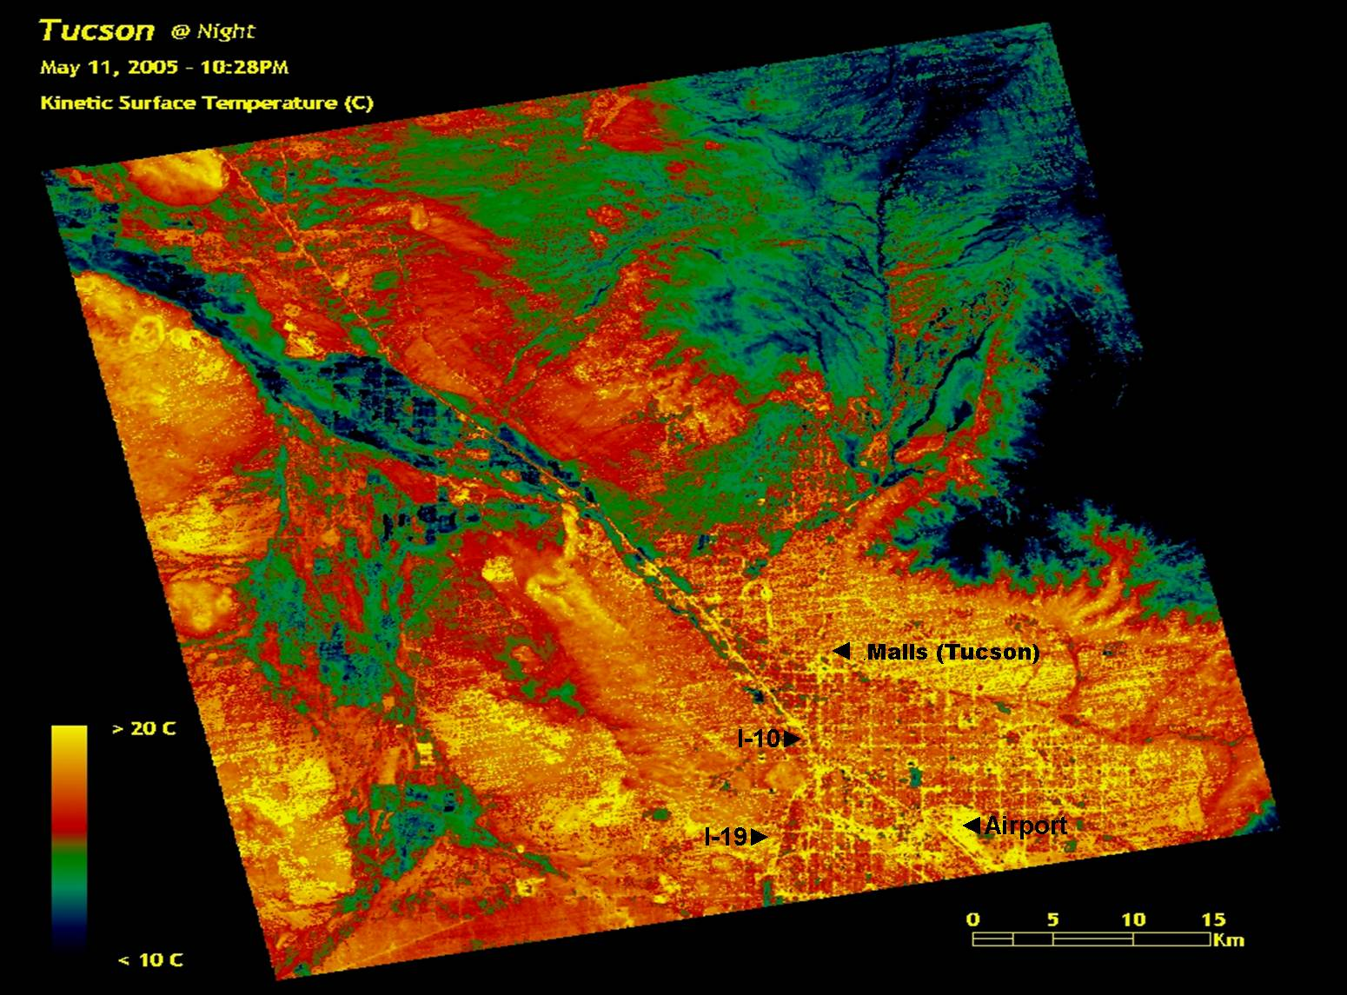
Economic Benefits of GI : in City of Tucson
The Business Case Evaluations for Tucson Projects
Function: Demonstrate range of net benefits
Method: AutoCASETM | Business Case Evaluator
Metrics: Monetizing values, life-cycle
calibrated to local weather, regional
economy, demographics
hot
Catalina Mts
cool
Dr. Jay Golden, ASU SMART Center, UHI presentation 2006
Reid Park
Tucson Basin | 2005 | Kinetic Surface Temperature

Slide 19
Economic Benefits of GI : in City of Tucson
The Business Case Evaluations for Tucson Projects
Function: Demonstrate range of net benefits
Method: AutoCASETM | Business Case Evaluator
Metrics: Monetizing values, life-cycle
calibrated to local weather, regional
economy, demographics
hot
Catalina Mts
cool
Tucson Projects
Dr. Jay Golden, ASU SMART Center, UHI presentation 2006
Elements: Low Impact/Green Infrastructure
Manual
Road: Silverbell Road
Road: Scott Avenue
Garden: Blue Moon
Reid Park
Tucson Basin | 2005 | Kinetic Surface Temperature

Slide 20
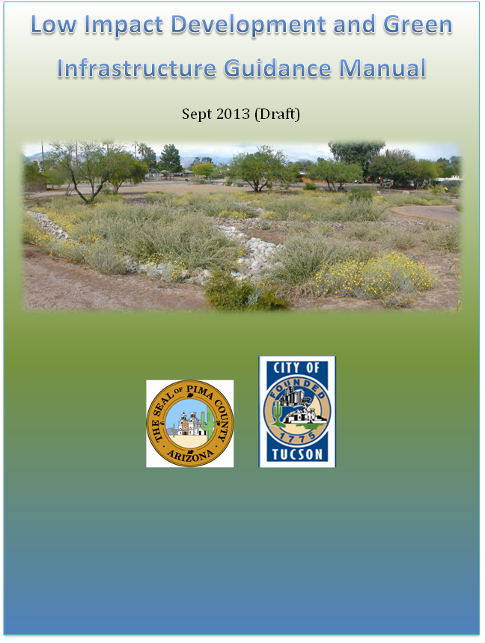
Economic Benefits of GI : in City of Tucson
◆ LID/GI Guidance Manual
Water Harvesting Basins /
Infiltration Basin
Bio Retention Basins
Xeriscape
SwalePervious Pavers /
Porous Pavement
Cistern
Bioretention
Curb Extensions
Function: Evaluate for Triple Bottom Line
Method: AutoCASETM

Slide 21
Economic Benefits of GI : in City of Tucson
◆ LID/GI Guidance Manual [Economist Lingo]
Use of universal values
Monetized social and environmental values
(some localized values included)

Slide 22
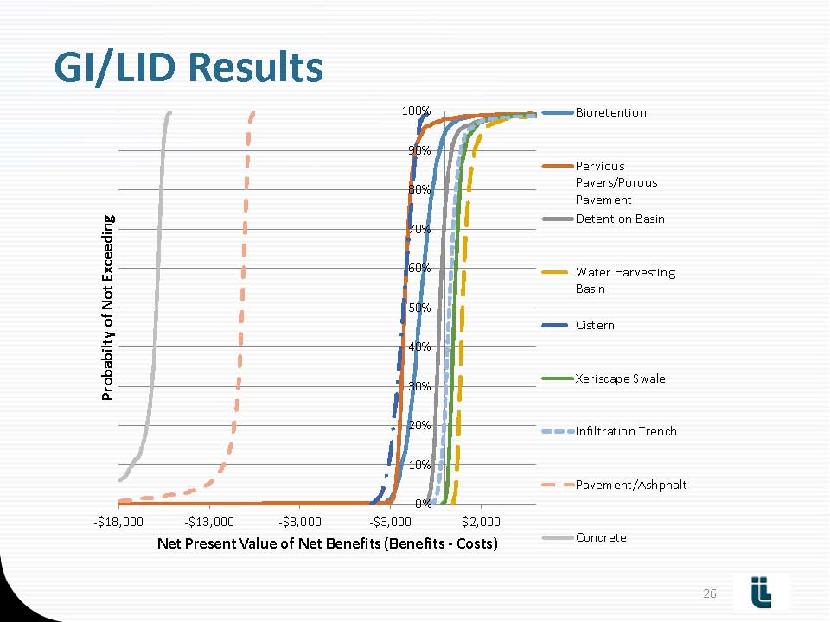
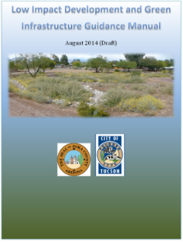
Economic Benefits of GI : in City of Tucson
$0
Concrete
Earthworks are most beneficial
Asphalt
Graph: Impact Infrustructure, LLC AutoCASE final report 7-2014

Slide 23
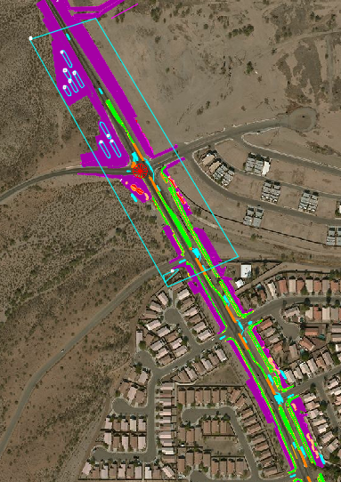
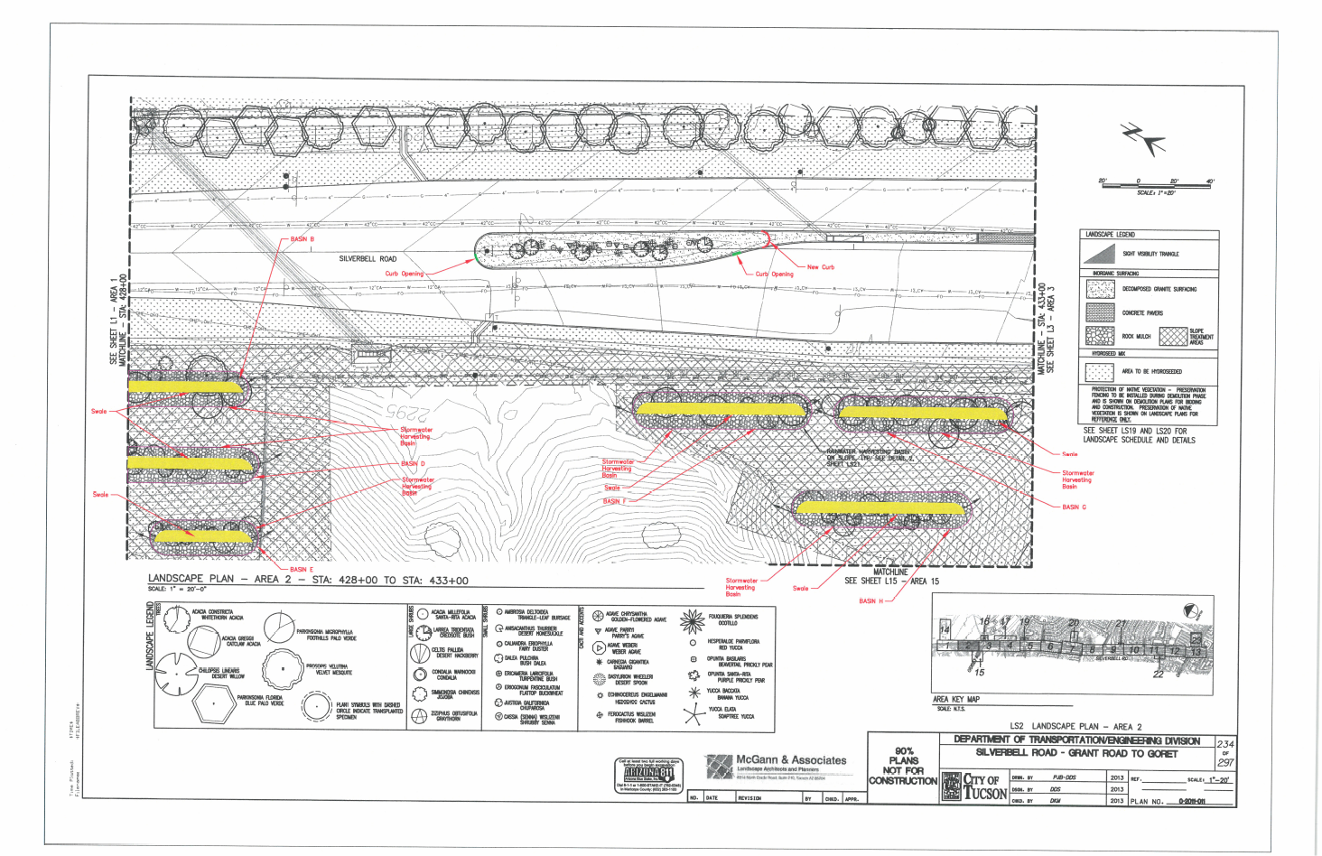
Economic Benefits of GI : in City of Tucson
❖ Silverbell Re-Design
Bioretention
Water harvesting basins
Trees
Traffic calming
Function: Evaluate Triple Bottom Line
Method: AutoCASETM

Slide 26
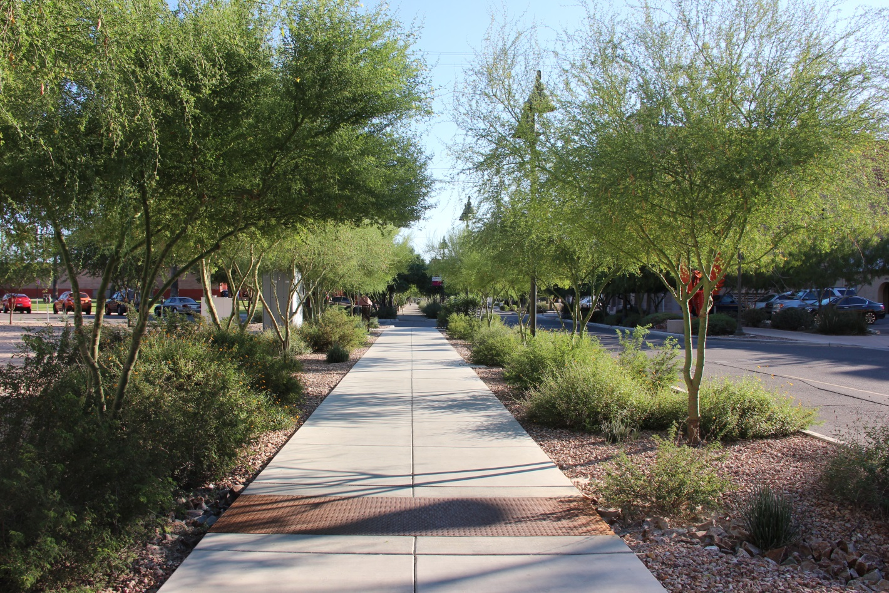
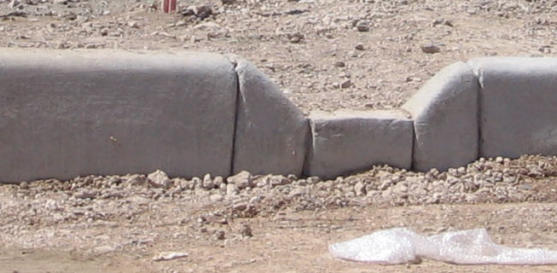
Economic Benefits of GI : in City of Tucson
⬥ Scott Avenue Re-Design
Bioretention
Water harvesting basins
Trees
[Traffic calming : road diet]
Scott Avenue
Construction curb cut : 2009
Function: Demonstrate range of net benefits = Triple Bottom Line
Method: Business Case Evaluator

Slide 27
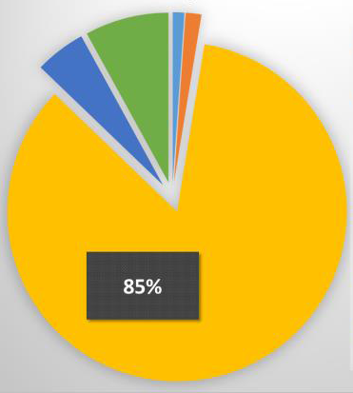
Economic Benefits of GI : in City of Tucson [WHAT BENEFIT]
Flood Risk
Property Values
⬥ Scott Avenue Re-Design
Air
Pollution
CO₂
Emissions
Social
Heat Stress Mortality
Environmental
Air Pollution
CO₂ Emissions
Flood risk
Economic
Property
✓
3
2
✓
✓
1
Heat Stress Mortality
✓
trees added to green Infrastructure
HAS community benefit

Slide 28
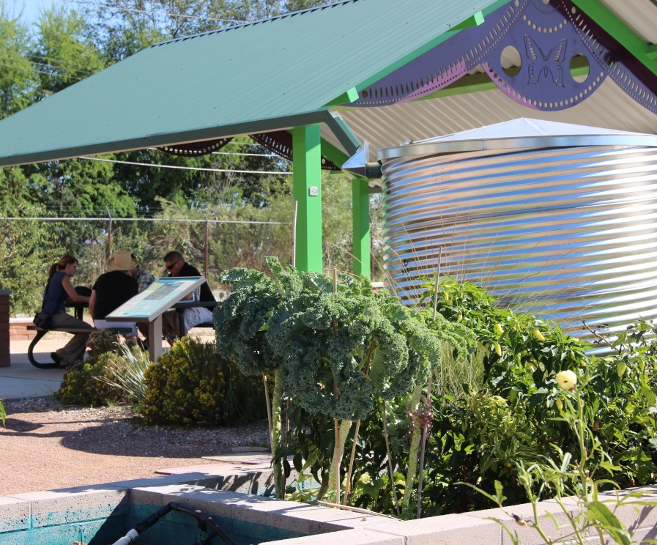
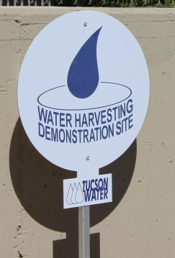
Economic Benefits of GI : in City of Tucson
 Blue Moon Community Gardens
Cistern
Water harvesting basins
Function: Demonstrate range of net benefits
Method: Business Case Evaluator

Slide 29
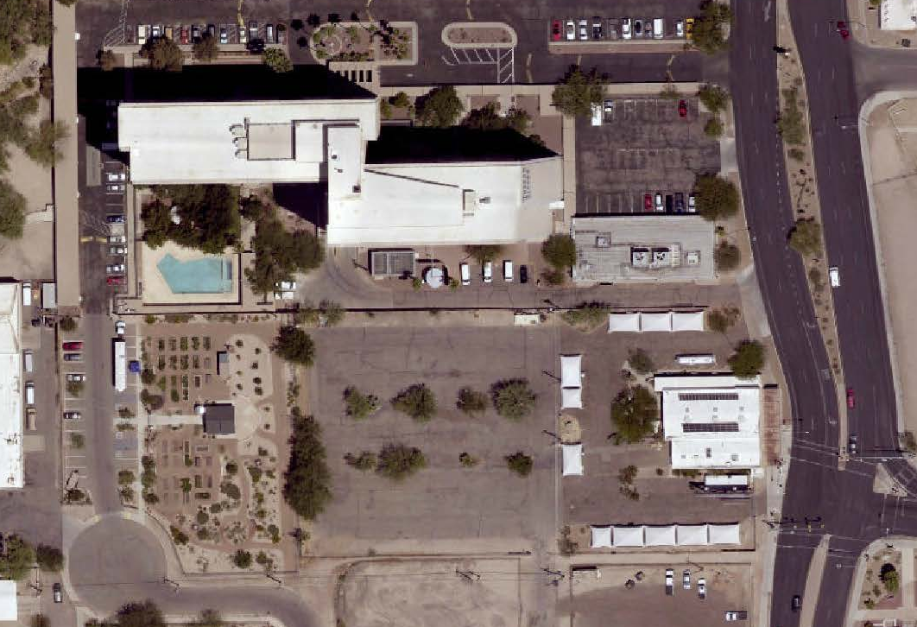
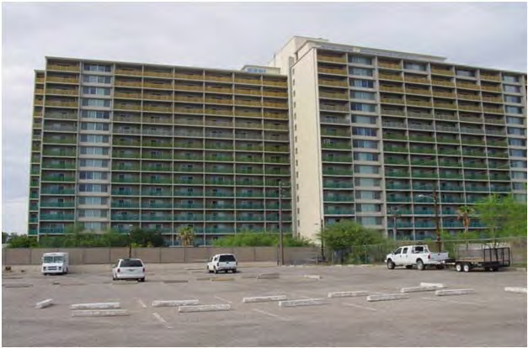
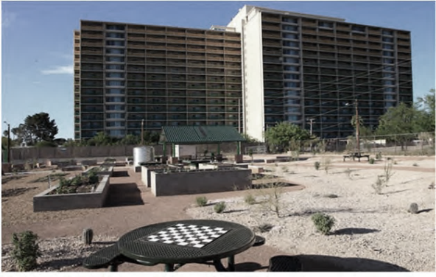
Economic Benefits of GI : in City of Tucson
 Blue Moon Community Gardens
Residents of Tucson House
Actively involved in design
Tucson
House
Before : 2011
Blue Moon
Community
Gardens
After : 2012

Slide 30
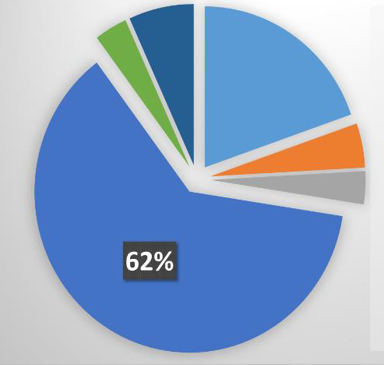
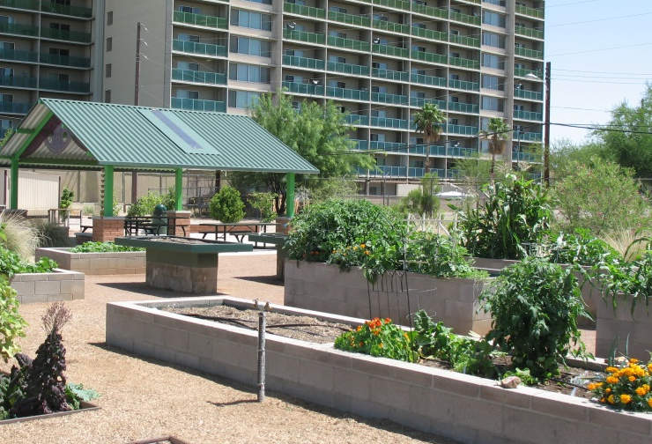
Economic Benefits of GI : in City of Tucson [WHAT BENEFIT]
 Blue Moon Community Gardens
Social
Heat Stress Mortality
Recreation
Environment
Air Pollution
Economic
CO2
Emissions
Air Pollution
3
2
Recreational
Use Value
1
Flood Risk
Property Value
Heat Stress
Mortality
Gi Economic Analysis Requires re-evaluation
Based on unique situations

Slide 31
Economic Benefits of GI : in City of Tucson
Correction on Beta Testing
Flood Risk
Air Pollution
Property Values
CO2
Emissions
Air
Pollution
3
2
CO₂
Emissions
3
2
Recreational
Use Value
1
Flood Risk
1
Property Value
Heat Stress
Mortality
Heat Stress Mortality

Slide 32



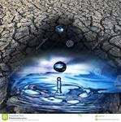

Economic Benefits of Green Infrastructure
A Few Considerations
climate change has altered weather patterns

Slide 33

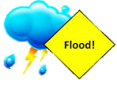


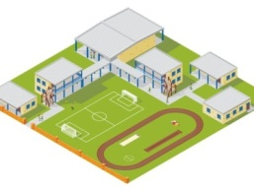
Economic Benefits of Green Infrastructure
River
Mountains
A Few Considerations
climate change has altered weather patterns
stormwater infrastructure standards changing
Streets
River
In Channel Recharge
Water Utility
Reclaimed Water

Slide 34
Economic Benefits of Green Infrastructure
A Few Considerations
climate change has altered weather patterns
stormwater infrastructure standards changing
Streets
Economic analysis part of informed
decision-making process

Slide 35
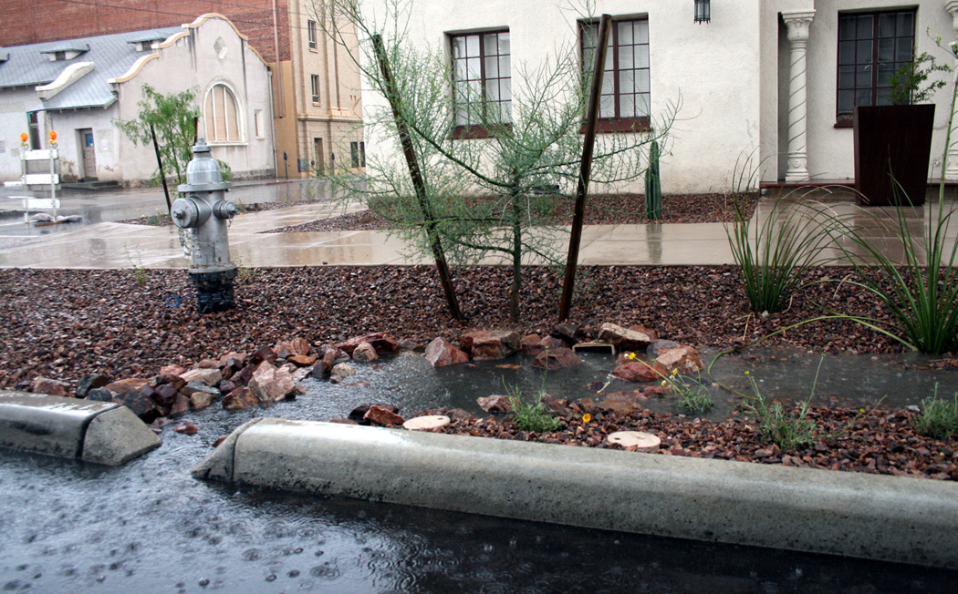
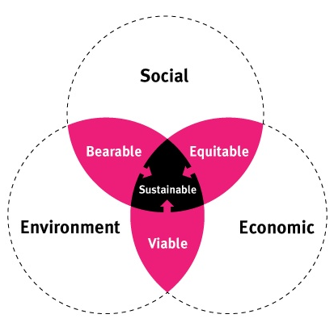
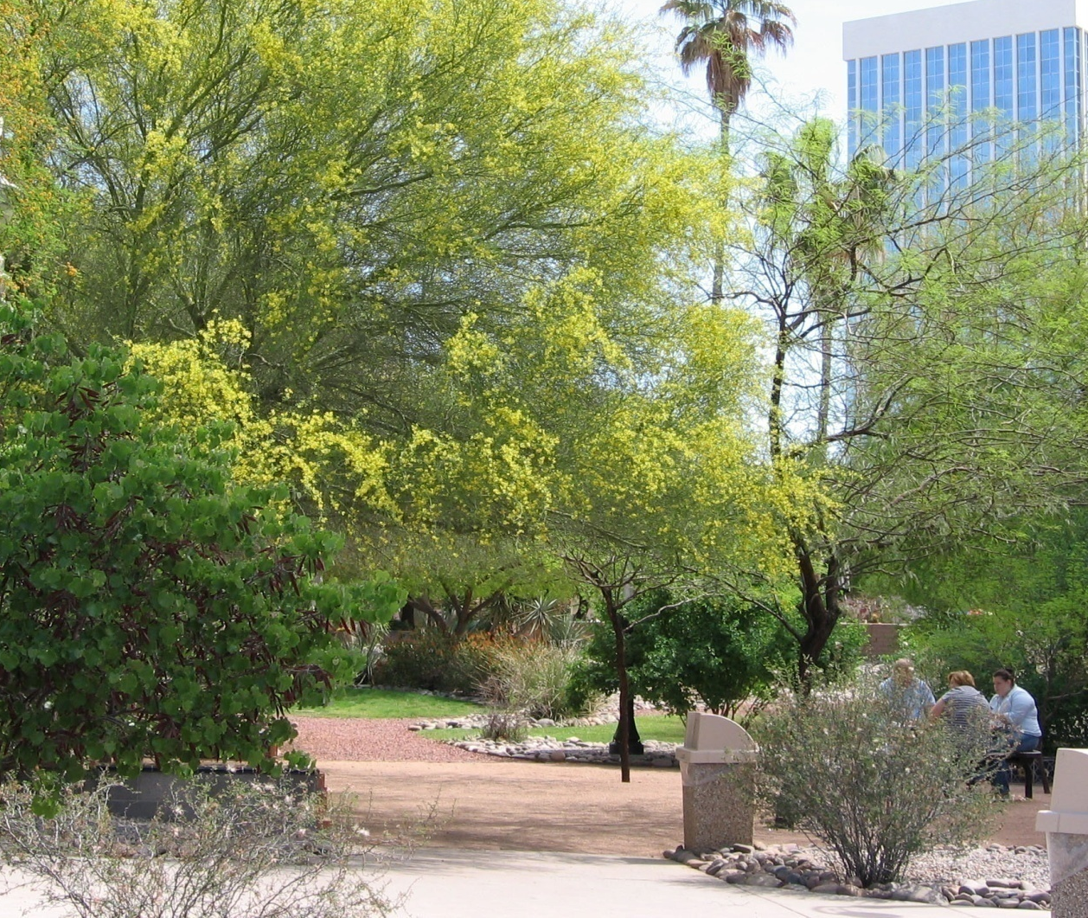
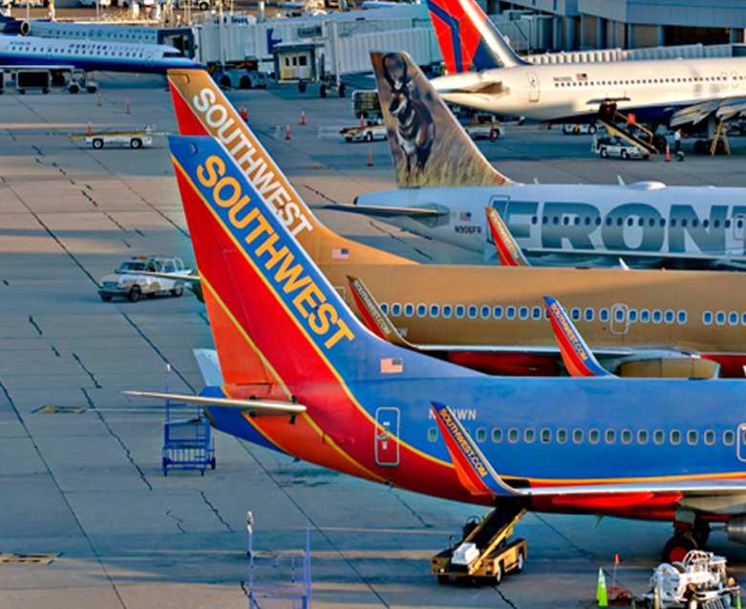

Economic Benefits of Green Infrastructure
SUMMARY TRIPLE BOTTOM LINE & NEXT STEP
Avoided Water Consumption
Recreation Improvements
Community Amenities – Urban Canopy
Protect/Improve Public Health
CO₂ Reduction •
Habitat Enhancement •
Water Quality Improvement •
Water for the Environment •
Life Cycle Costs
Governance – Fiduciary Responsibility
Reduced Flood Damage
Water Security

Slide 36








Acknowledgements
Office of Integrated Planning
Tucson Water
DOT

Slide 37
Resources
Pima County LID Working Group Website:
http://webcms.pima.gov/cms/one.aspx?portalId=169&pageId=65263
http://webcms.pima.gov/cms/one.aspx?portalId=169&pageId=65263
AutoCASETM Beta Testing Project: Evaluation of GI/LID Benefits in the Pima County Environment:
Same as above
Business Case Evaluator for Stormwater Management Website:
https://autocase.com/sites/
Contact: irene.ogata@tucsonaz.gov

Slide 38


Questions
Irene Ogata, PLA, ASLA, AzAPA
Urban Landscape Manager
  irene.ogata@tucsonaz.gov

