Slide 1
Your association working for you
Welcome!
A Night Out With ANA

Slide 2
Your association working for you
Celebrating 60 Years!

Slide 3
Your association working for you
Arizona Nursery Association
150
Member Companies Strong!

Slide 4
Your association working for you
Arizona Nursery Association
2019 ANA Events & Activities

Slide 5
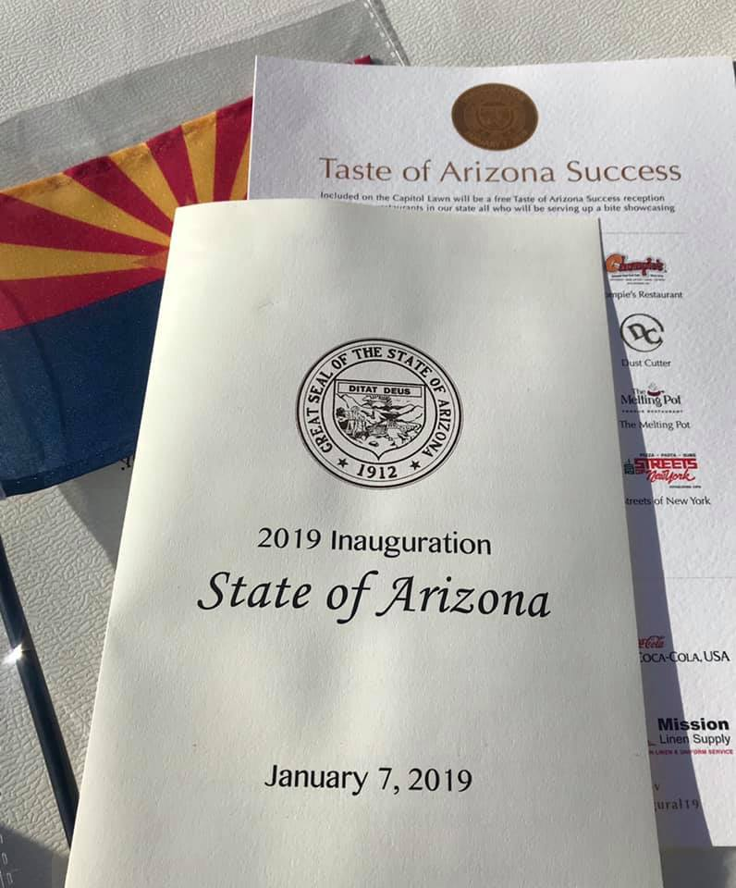
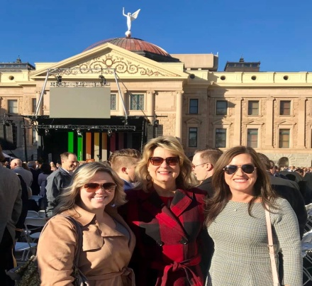
2019 ANA Events & ACTIVITIES Your association working for you
2019 State of Arizona Inauguration
ANA staff and lobbyist, AnnaMarie Knorr were able to attend Governor Doug Ducey’s 2019 inauguration at the State Capitol in January of this year.

Slide 6
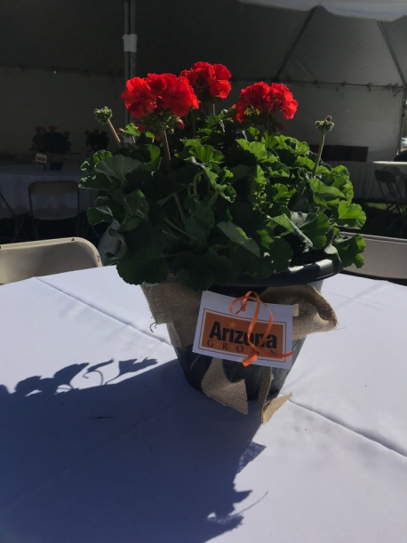
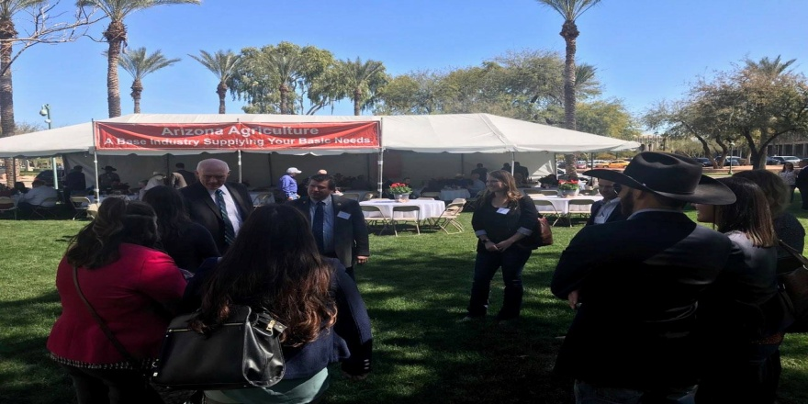
2019 ANA Events & ACTIVITIES Your association working for you
Legislative Agriculture Luncheon
Legislators and ag commodity group leaders were able to mingle and discuss issues at the luncheon at the State Capitol.

Slide 7
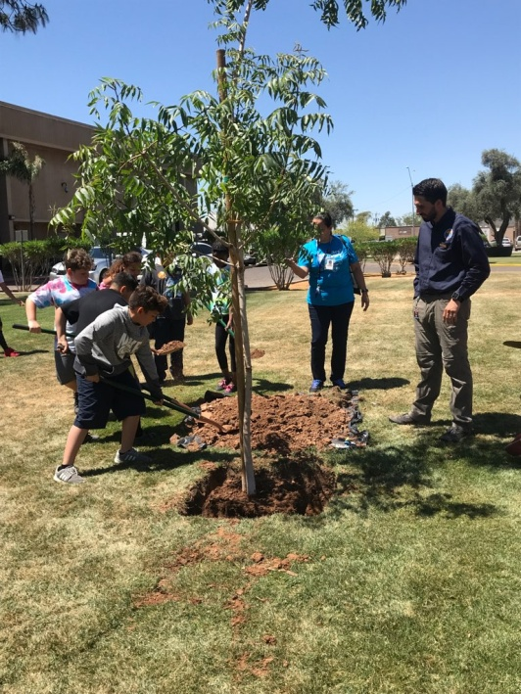
2019 ANA Events & ACTIVITIES Your association working for you
Arbor Day at the Capitol
ANA was able to work with Mountain States Wholesale Nursery on the tree donation for Arbor Day this year as well as SRP, the Department of Forestry and Fire Management and ACTC in coordinating the event.

Slide 8
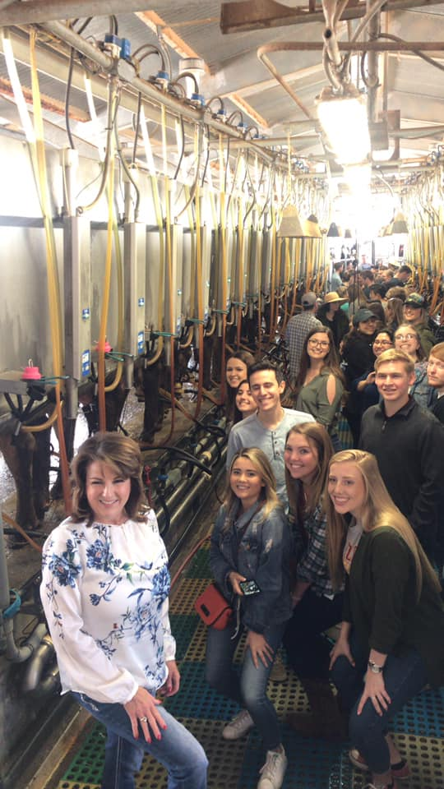
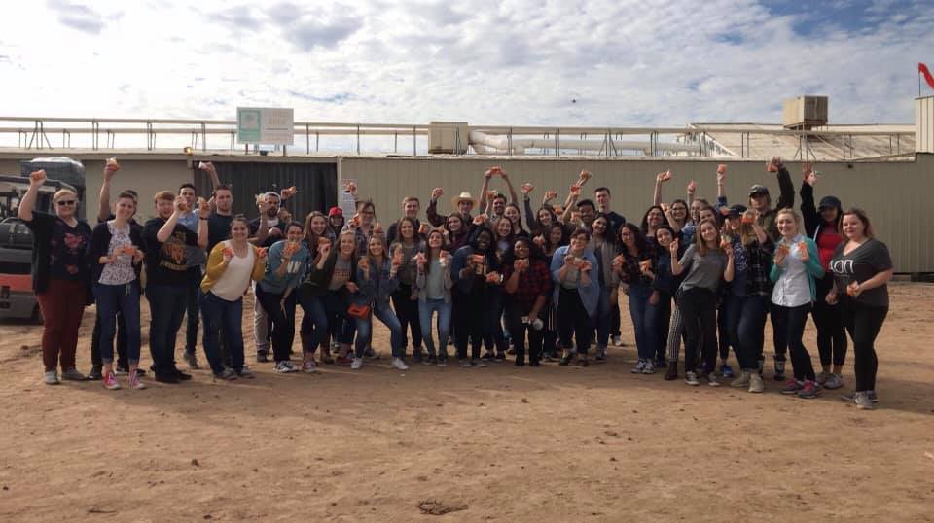
2019 ANA Events & ACTIVITIES Your association working for you
Legislative Ag Intern Tour
Thanks Mountain States Whole Nursery for participating in this tour with legislative interns this year!

Slide 9
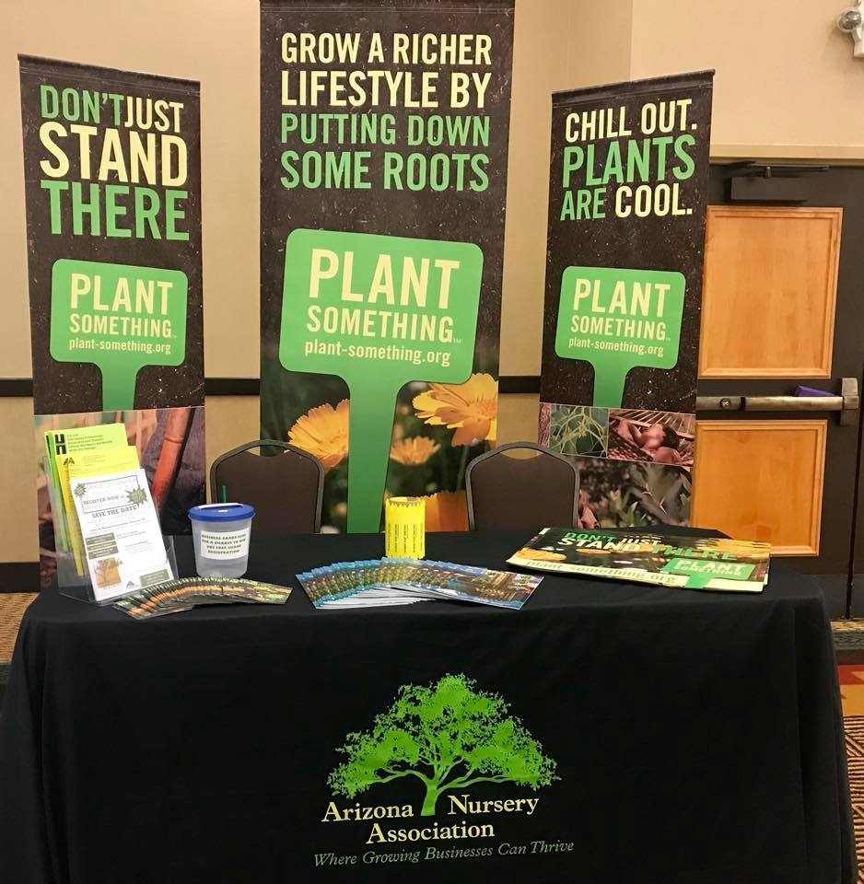
2019 ANA Events & ACTIVITIES Your association working for you
ACTC Conference
ANA displayed a booth at the Arizona Community Tree Council annual conference in Prescott this year. Thanks ACTC for the invitation!

Slide 10
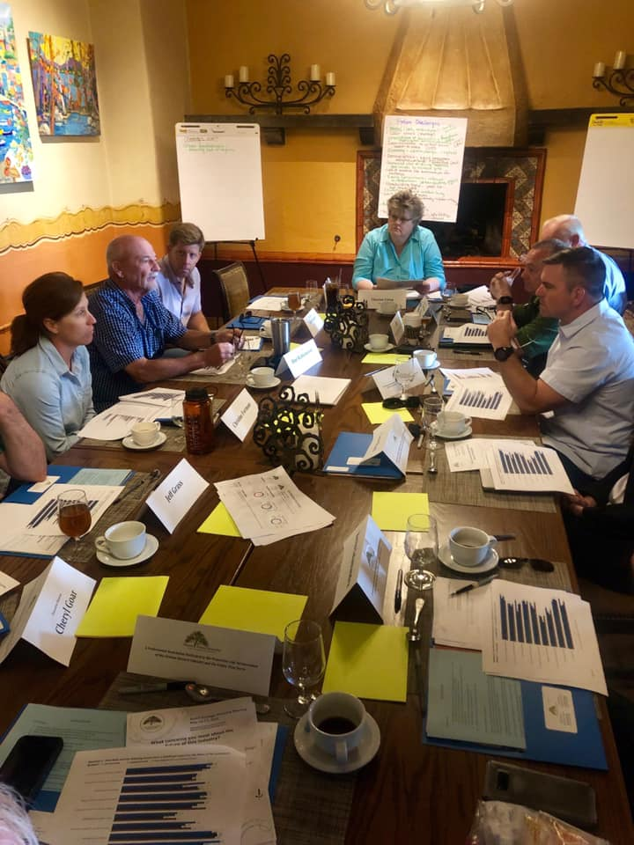
2019 ANA Events & ACTIVITIES Your association working for you
Long Range Planning
Thank you ANA board members for all your work in planning for 2021!

Slide 11
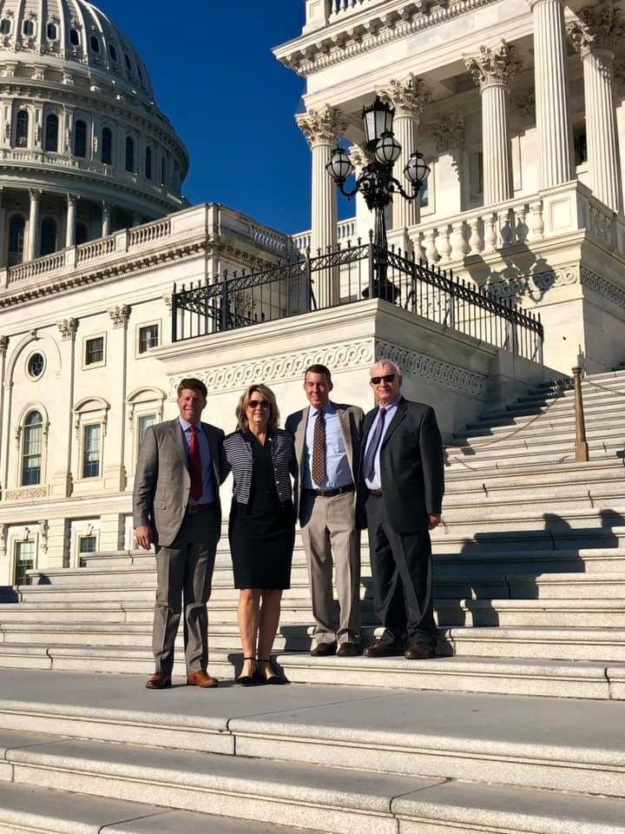
2019 ANA Events & ACTIVITIES Your association working for you
Impact Washington
ANA Executive Director Cheryl Goar, President Les Shipley and President-Elect Tyler Francis joined AmericanHort for their Impact Washington event in D.C.

Slide 12
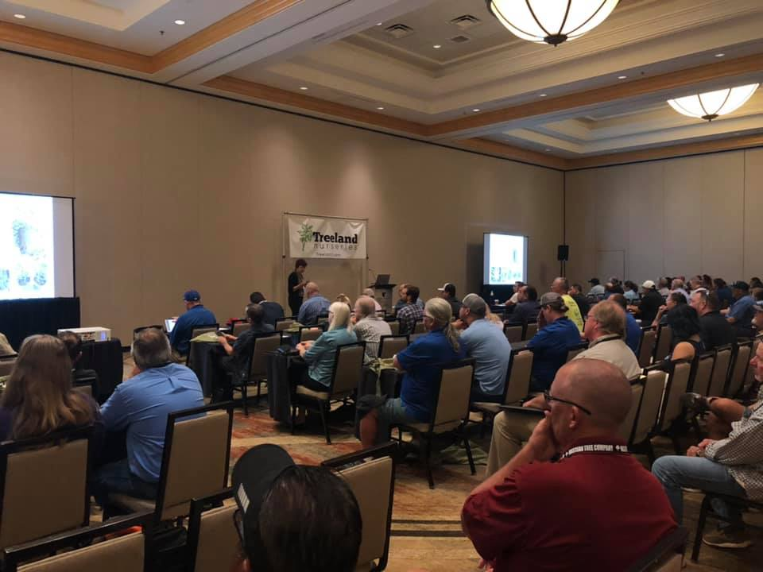
2019 ANA Events & ACTIVITIES Your association working for you
2019 SHADE Conference
SHADE was held at the JW Marriott Desert Ridge Resort in Phoenix this year on August 30.

Slide 13
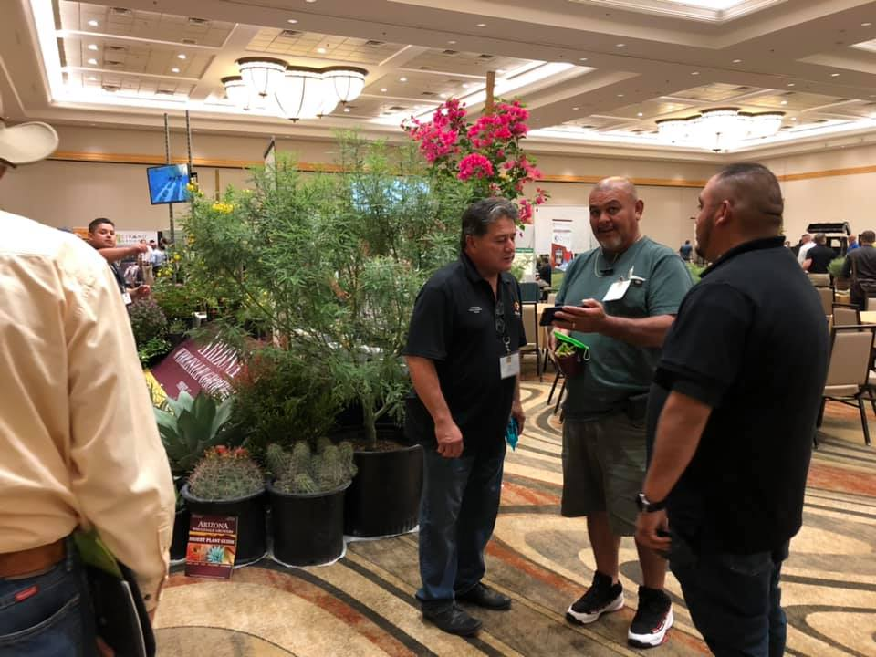
2019 ANA Events & ACTIVITIES Your association working for you
2019 SHADE Conference
We had 61 sponsors and 515 attendees…

Slide 14
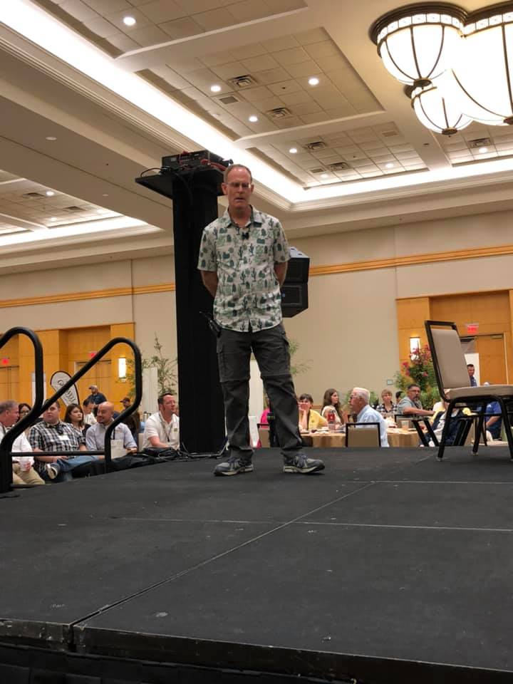
2019 ANA Events & ACTIVITIES Your association working for you
2019 SHADE Conference
…and 24 different sessions with a variety of speakers.
Thanks to all those who attended and made it a success!

Slide 15
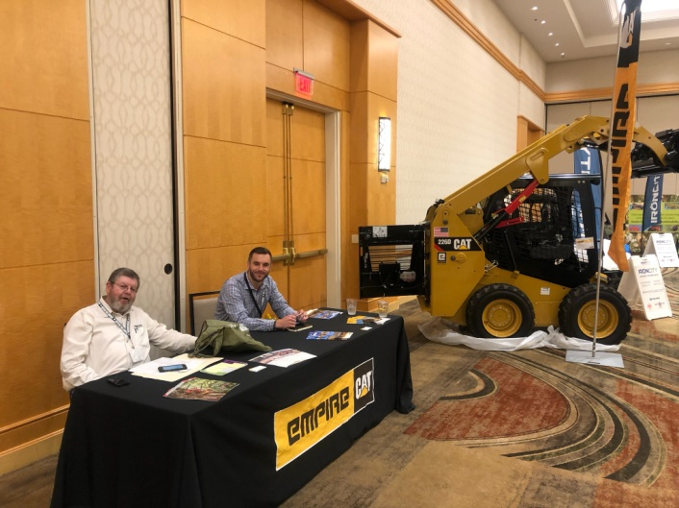
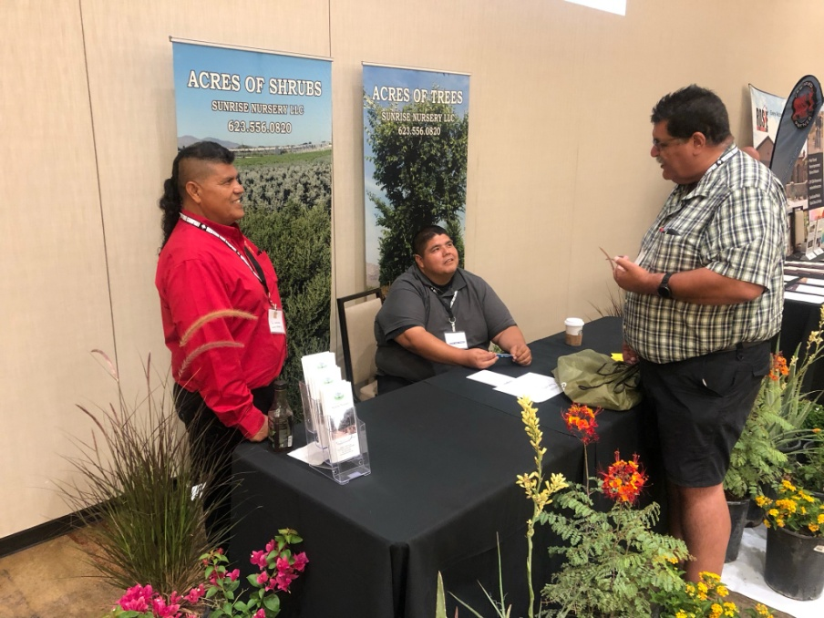
2019 ANA Events & ACTIVITIES Your association working for you
2019 SHADE Conference

Slide 16
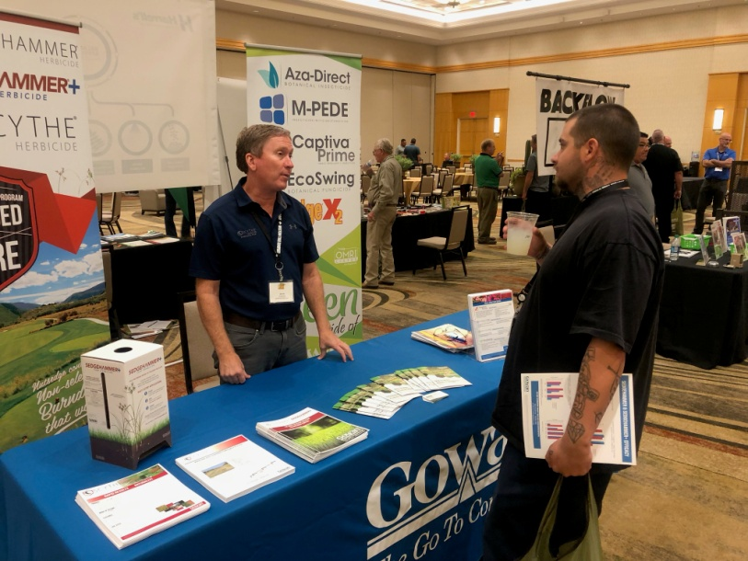
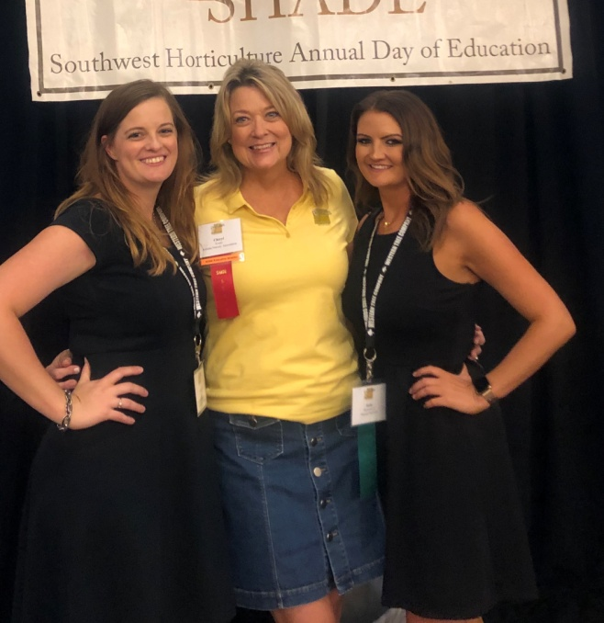
2019 ANA Events & ACTIVITIES Your association working for you
2019 SHADE Conference

Slide 17
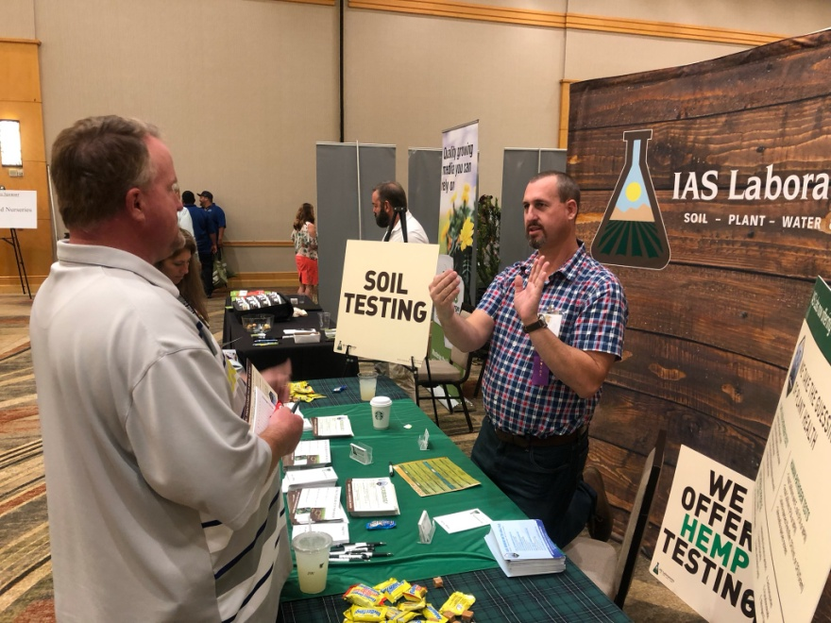
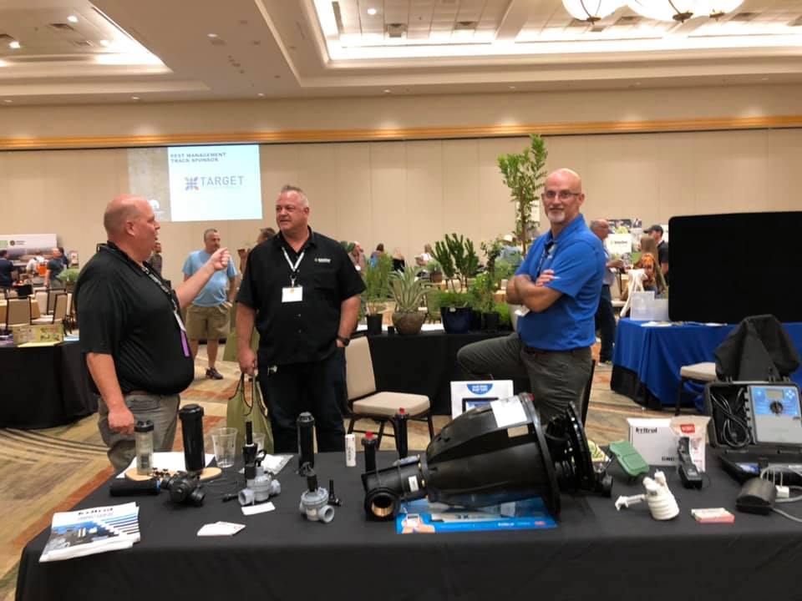
2019 ANA Events & ACTIVITIES Your association working for you
2019 SHADE Conference

Slide 18
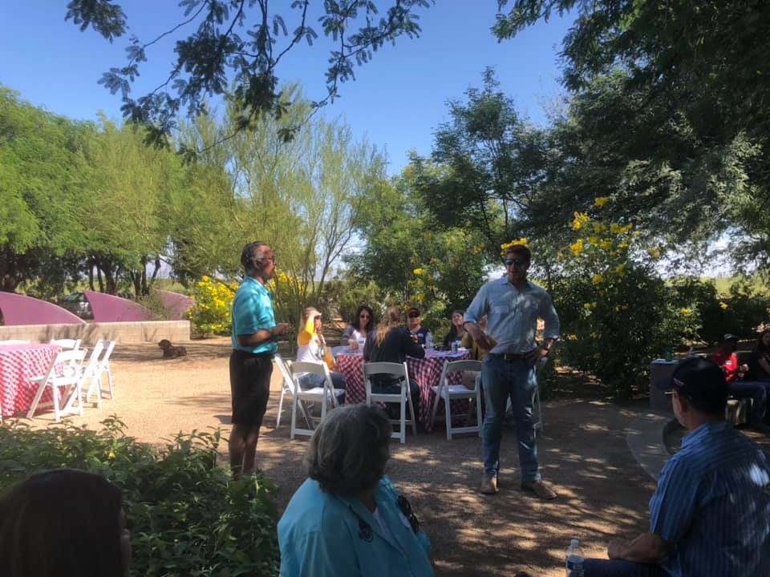
2019 ANA Events & ACTIVITIES Your association working for you
AZT Day Out
NEW EVENT! Arid Zone Trees hosted it’s Day Out presented by ANA this year. If you want to host one, talk to Cheryl or Shayla!

Slide 19
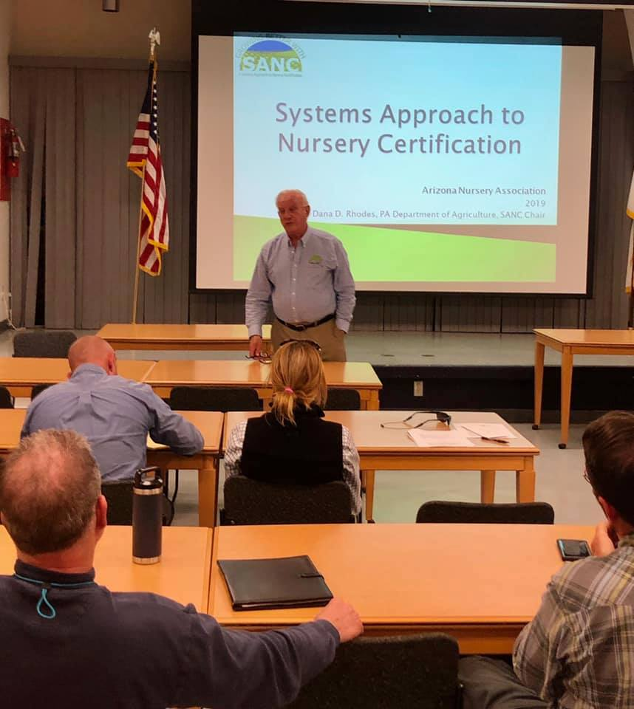
2019 ANA Events & ACTIVITIES Your association working for you
SANC Special Presentation
ANA and AZDA partnered up to talk with growers about the Systems Approach to Nursery/Greenhouse Stock Certification at the Maricopa County Cooperative Extension.

Slide 20
Your association working for you
Arizona Nursery Association
Legislative Activity

Slide 21
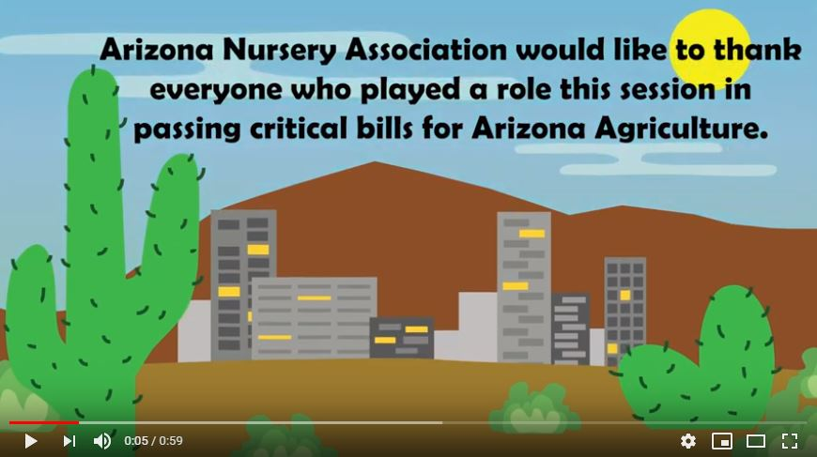
Your association working for you
Legislative Activity
TPT Tax Clarification is law! Ending sales tax on commercial fertilizer and pesticide sales.

Slide 22
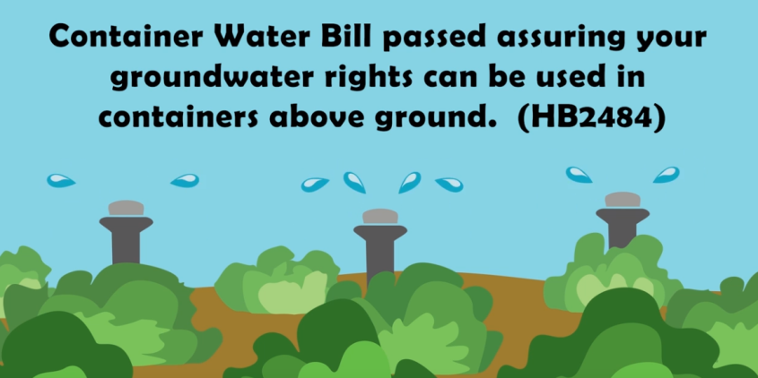
Your association working for you
Legislative Activity
Container Water Bill passed assuring groundwater rights can be used above ground.

Slide 23
Your association working for you
Legislative Activity
Largest conservation plan in Arizona History; $20 M of resources for Central Arizona irrigation infrastructure.

Slide 24
Legislative Activity Your association working for you
2018 Economic Impact Survey Released!
ANA and ALCA are excited to report the 2018 Arizona Green Industry Economic Report is available now showing a $1.4 billion industry! Grab yours tonight before you leave!

Slide 25
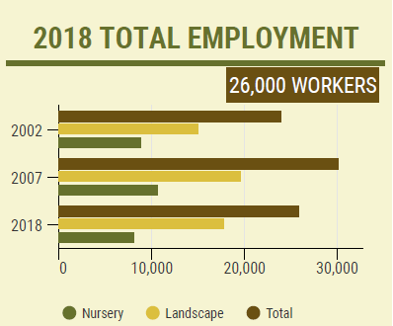
Legislative Activity Your association working for you
2018 Economic Impact Survey Released!
The Green Industry provided direct employment to
26,000 hired workers in 2018.

Slide 26
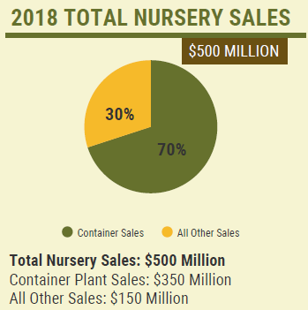
Legislative Activity Your association working for you
2018 Economic Impact Survey Released!
Nursery sales totaled $500 Million. Labor still continues to be the major issue in the industry.

Slide 27
Legislative Activity Your association working for you
Thank you!
Thank you to Representative Tim Dunn, Representative Sine Kerr, Representative Gail Griffin, Senator David Farnsworth, Senator Vince Leach, Senator Michelle Ugenti-Rita, Senator David Livingston and Chairman JD Mesnard for all their work on these legislative issues with ANA!

Slide 28
Your association working for you
Arizona Nursery Association
Out and About

Slide 29
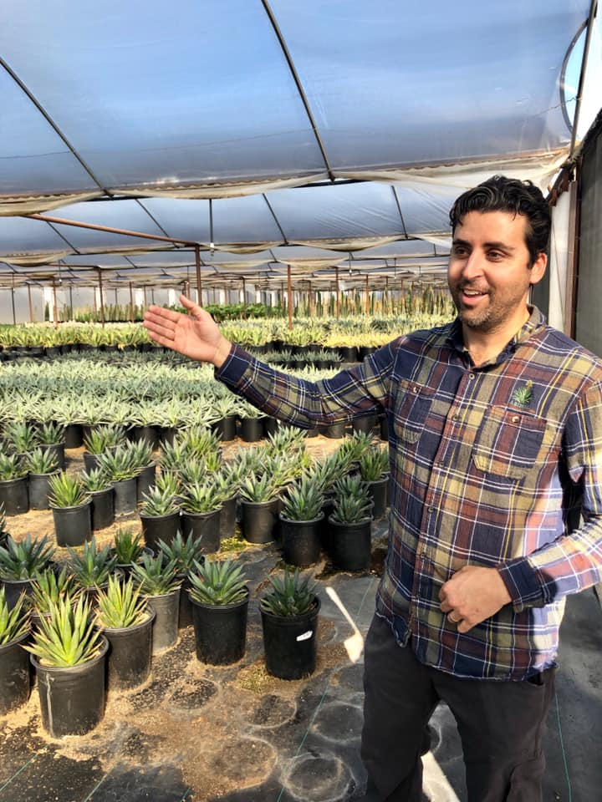
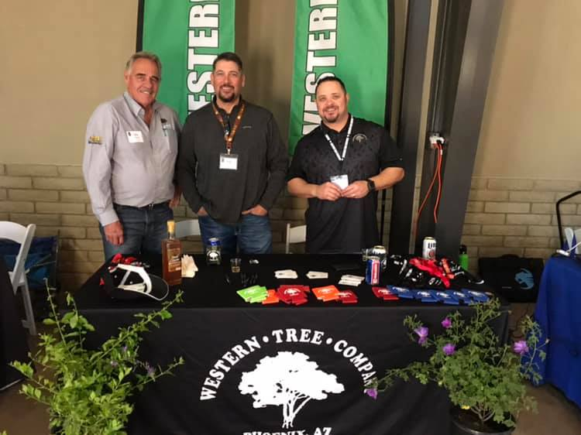
OUT and about Your association working for you
Arizona Nursery Association

Slide 30
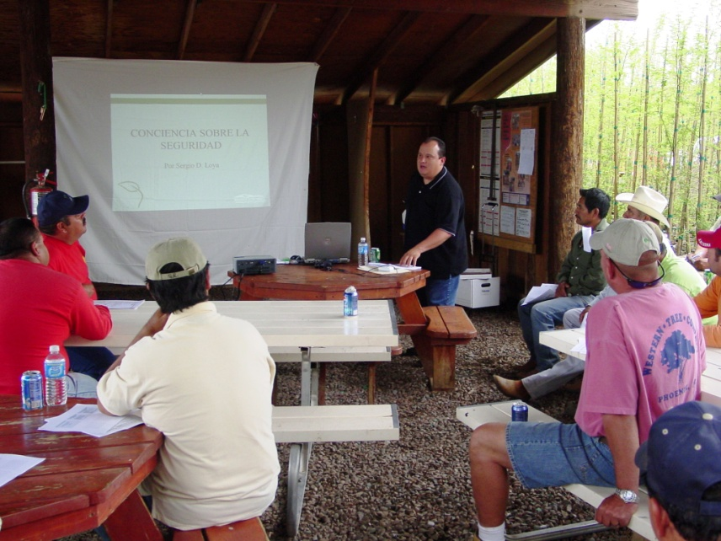
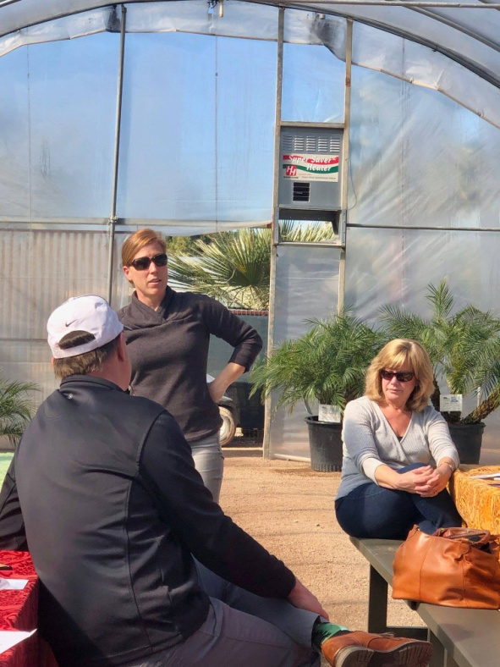
OUT and about Your association working for you
Arizona Nursery Association

Slide 31
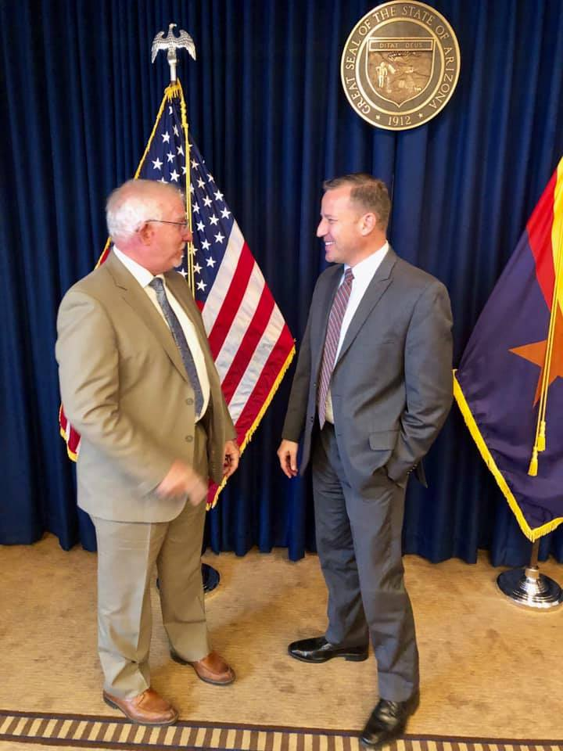
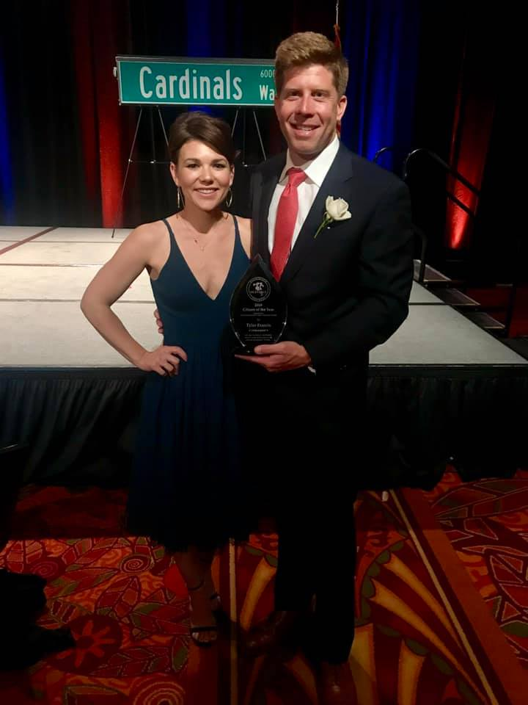
OUT and about Your association working for you
Arizona Nursery Association

Slide 32
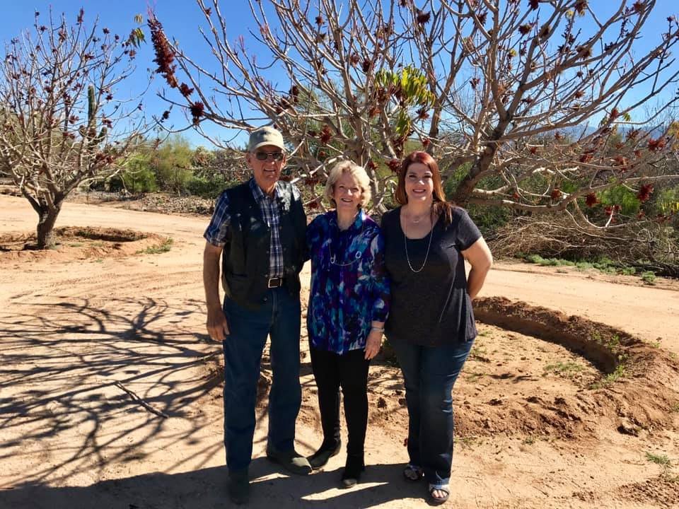
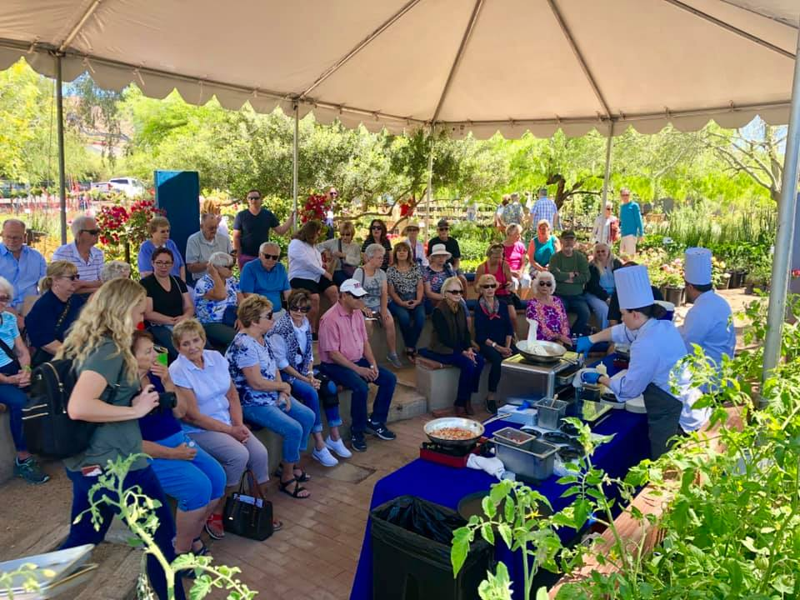
OUT and about Your association working for you
Arizona Nursery Association

Slide 33
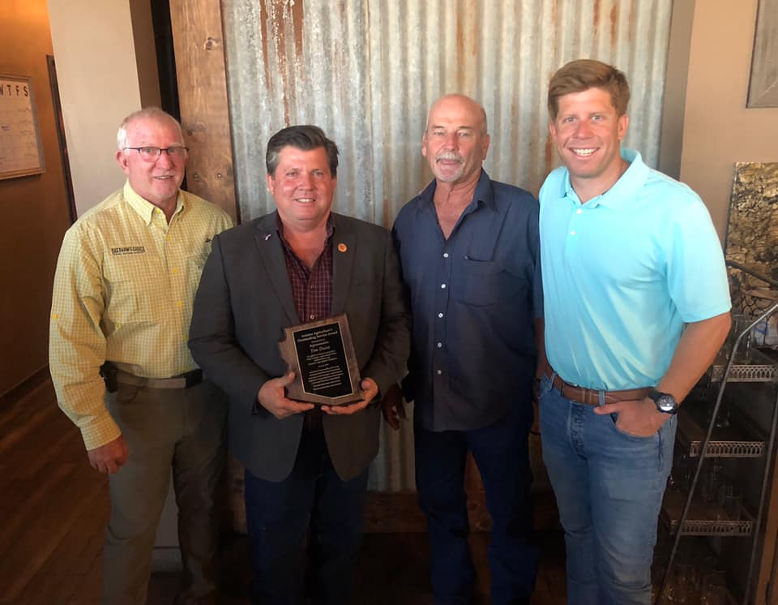
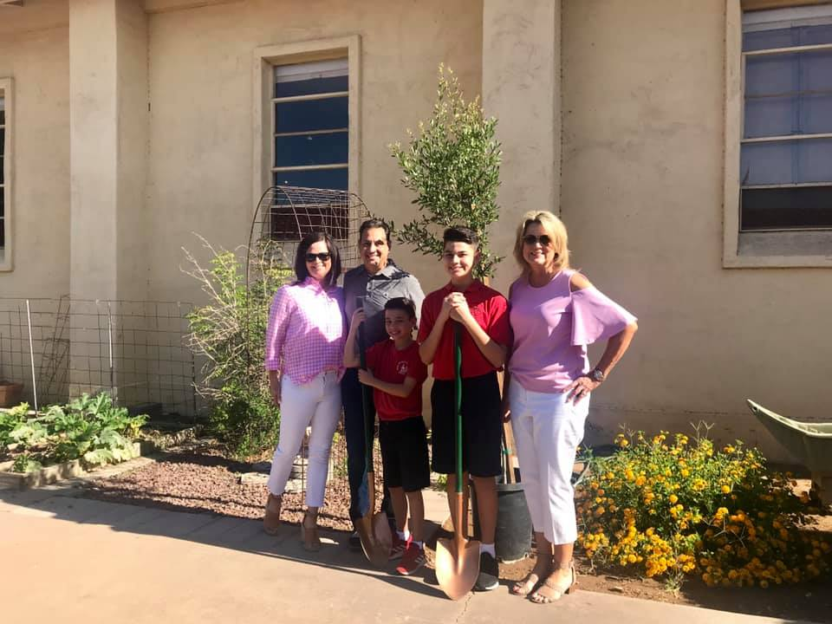
OUT and about Your association working for you
Arizona Nursery Association

Slide 34
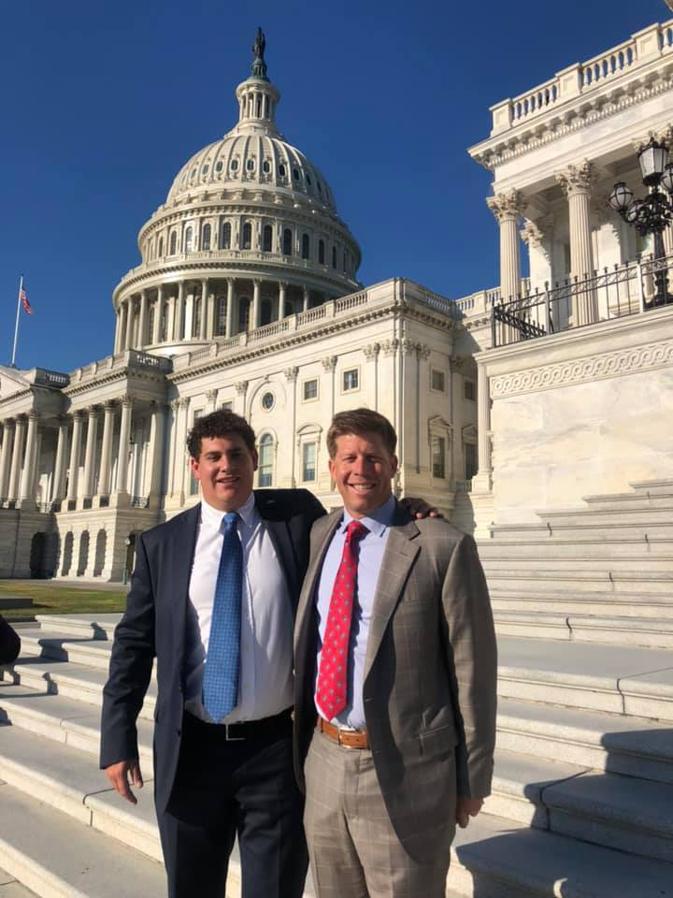
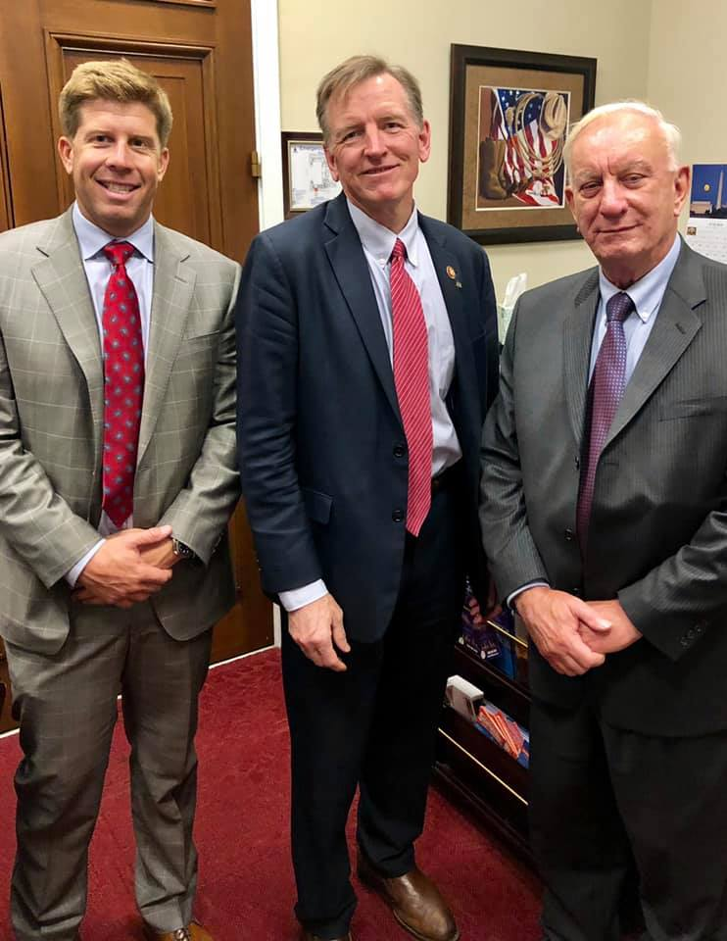
OUT and about Your association working for you
Arizona Nursery Association

Slide 35
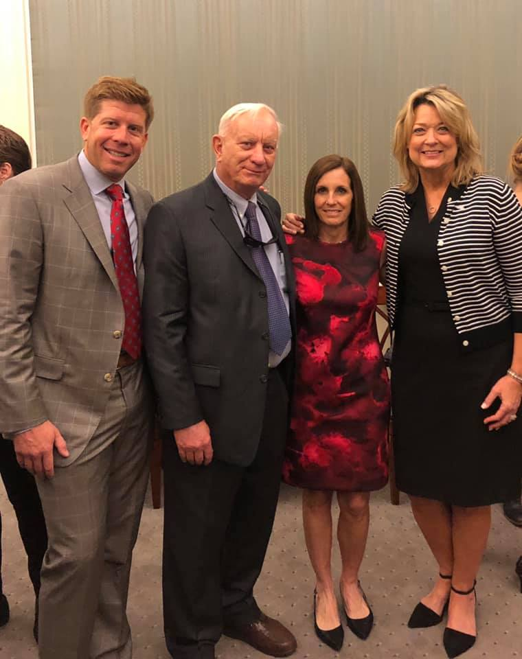
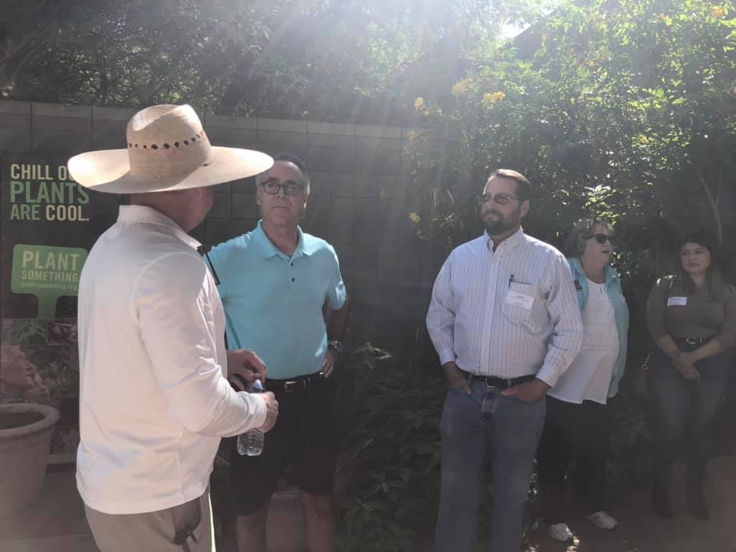
OUT and about Your association working for you
Arizona Nursery Association

Slide 36
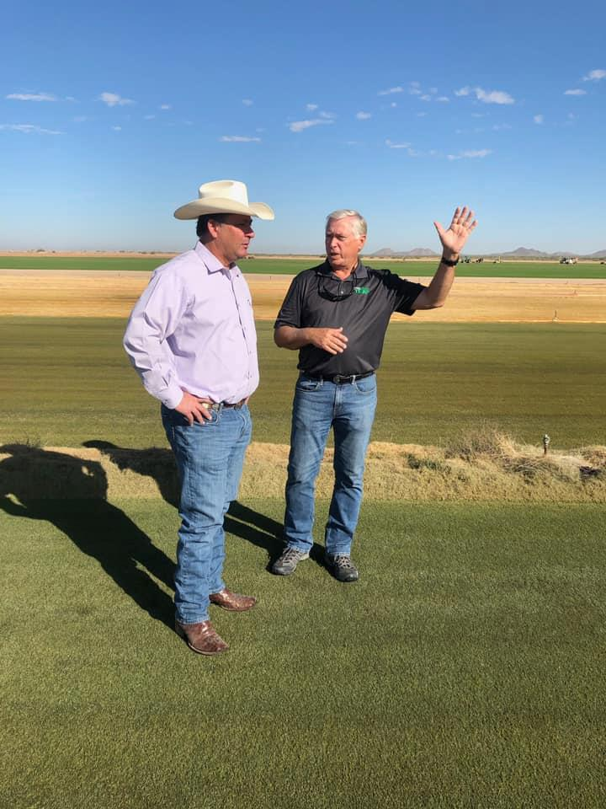
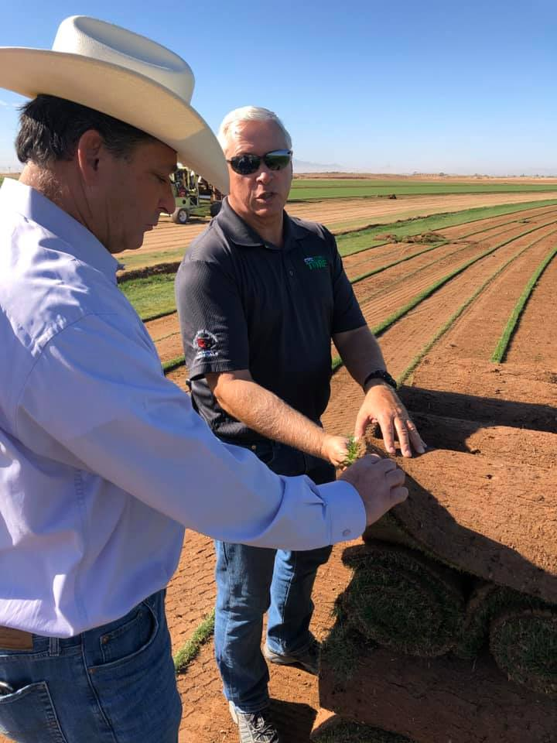
OUT and about Your association working for you
Arizona Nursery Association

Slide 37
Your association working for you
Arizona Nursery Association
ANAFUND Scholarship Program

Slide 38
Your association working for you
Arizona Nursery Association
ANAFUND awarded scholarships to 14 individuals totaling $35,400!

Slide 39
Your association working for you
Arizona Nursery Association
Here are the recipients…

Slide 40
ANAFUND Scholarship Program Your association working for you
Congratulations!
Lauren Reeves, 22
From Chandler, AZ
Junior at Arizona State University for Landscape Architecture/Sustainability
GPA 3.7
$2,500 General Funds

Slide 41
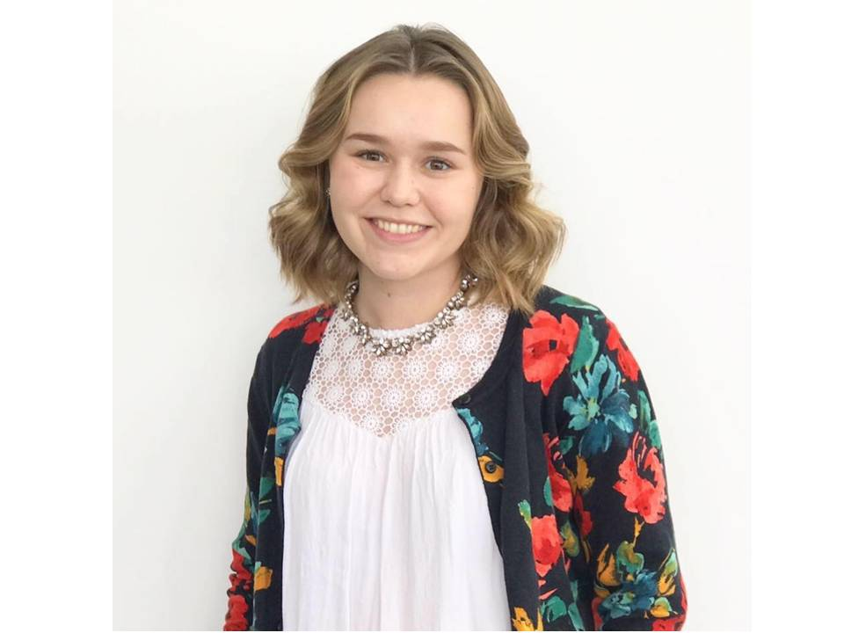
ANAFUND Scholarship Program Your association working for you
Congratulations!
Paige Gangloff, 21
From Phoenix, AZ
Junior at the University of Arizona for Ag Tech Mgmt & Education
GPA 3.5
$675 Farber, $650 Becker and $1,000 General Funds

Slide 42
ANAFUND Scholarship Program Your association working for you
Congratulations!
Amy Cejka, 21
From Phoenix, AZ
Junior at Mesa Community College for Greenhouse Management
GPA 3.73
$625 Cusma, $525 O’Riley and $500 Waltemeyer Funds

Slide 43
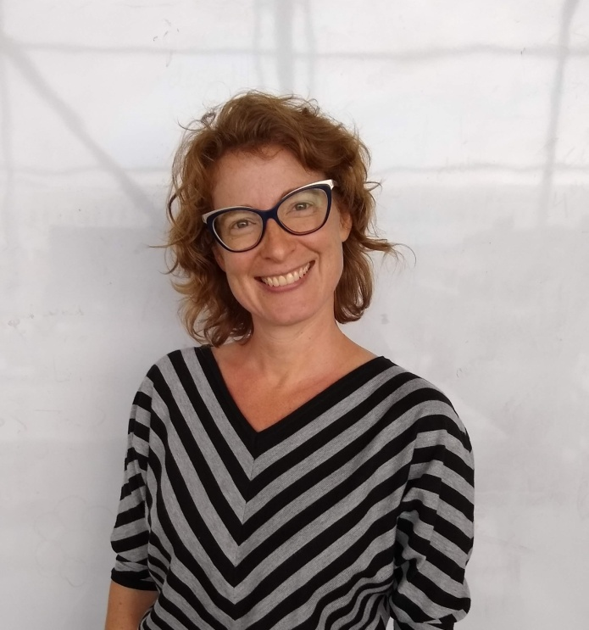
ANAFUND Scholarship Program Your association working for you
Congratulations!
Paige Anthony, 42
From Tucson, AZ
Junior at the University of Arizona for Landscape Architecture
GPA 4.0
$2,000 Williams and $1,000 General Funds

Slide 44
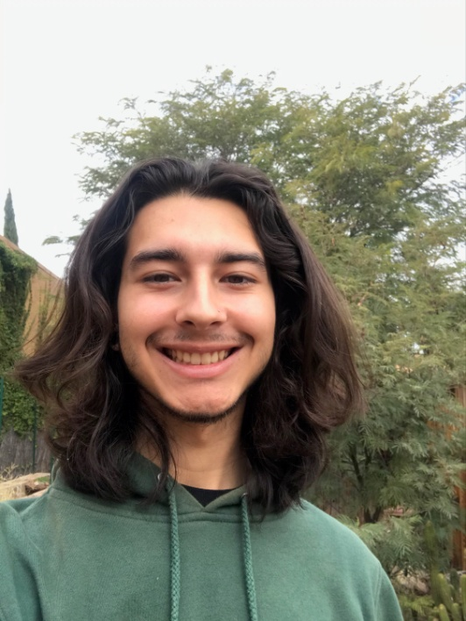
ANAFUND Scholarship Program Your association working for you
Congratulations!
Mateo Escamilla, 19
From Tucson, AZ
Sophomore at the University of Arizona for Sustainable Plant Systems
GPA 2.67
$425 Riding, $250 McGrath and $2,000 General Funds

Slide 45
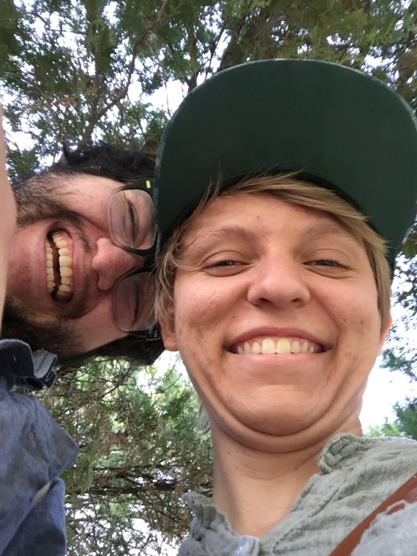
ANAFUND Scholarship Program Your association working for you
Congratulations!
Rachael Fulton, 25
From Phoenix, AZ
Junior at Arizona State University for Landscape Architecture
GPA 4.0
$700 Gass, $700 Wheat, $650 AzAS:A and $450 Jones Funds

Slide 46
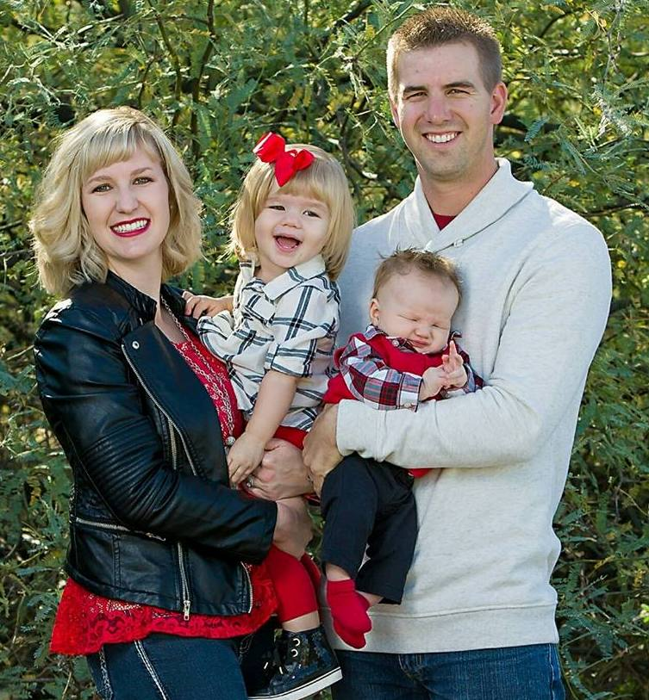
ANAFUND Scholarship Program Your association working for you
Congratulations!
Taylor McCleary, 29
From San Tan Valley, AZ
Junio at Arizona State University for Landscape Architecture
GPA 3.76
$275 Harper, $250 Greg Augustine, $250 Berridge and $1,000 General Funds

Slide 47
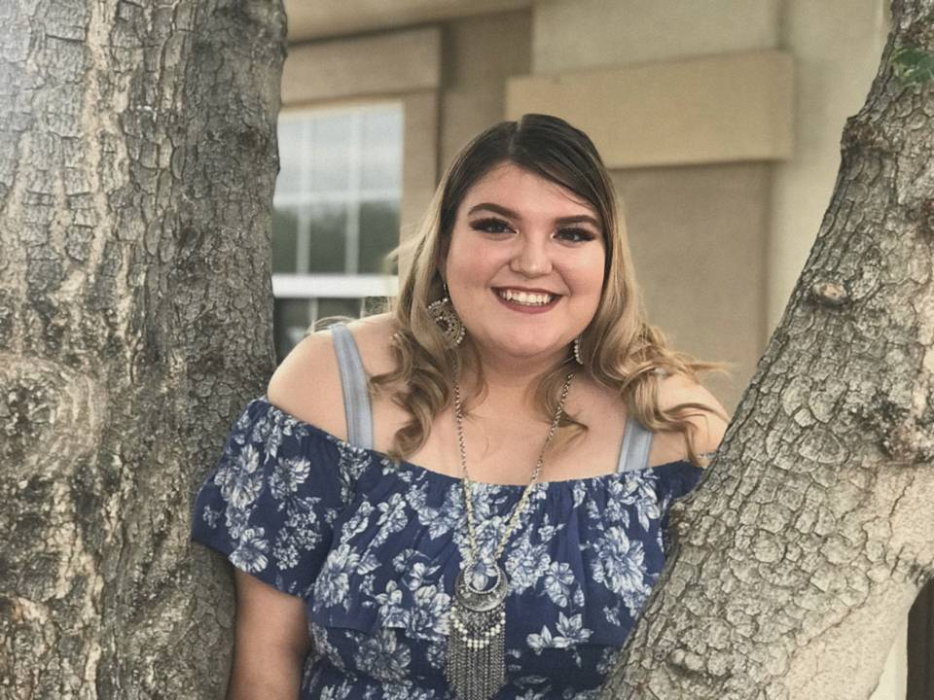
ANAFUND Scholarship Program Your association working for you
Congratulations!
Shelby Humbarger, 18
From Mayer, AZ
Freshman at the University of Arizona for Agriculture Education
GPA 3.46
$1,350 Hemminghaus, $1,100 Kazan and $900 Kolley Funds

Slide 48
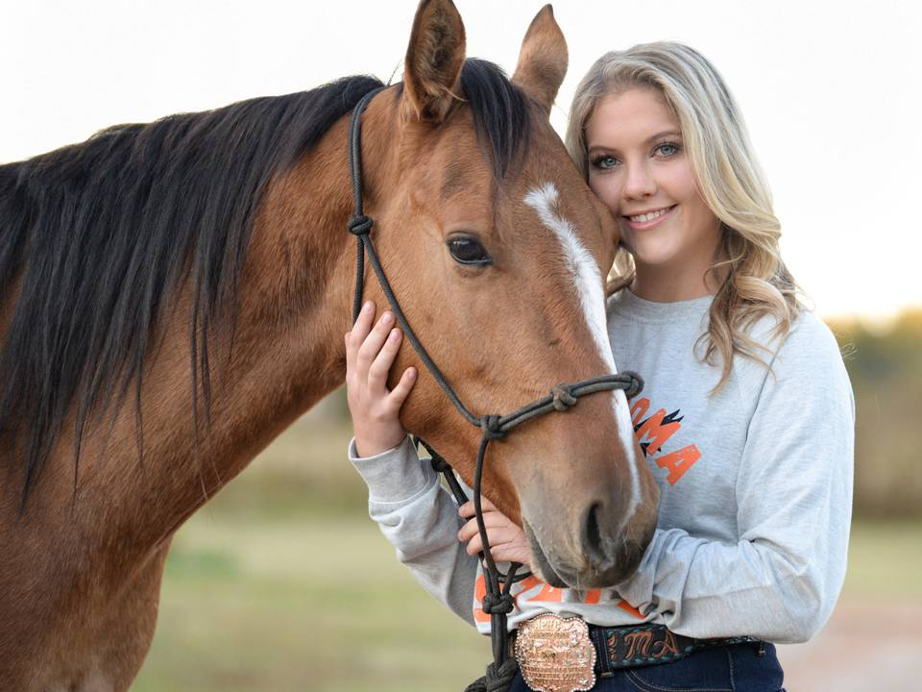
ANAFUND Scholarship Program Your association working for you
Congratulations!
Madeline Alewine, 22
From Buckeye, AZ
Senior at Oklahoma State University for Ag Business
GPA 3.4
$3,550 Augustine Funds

Slide 49
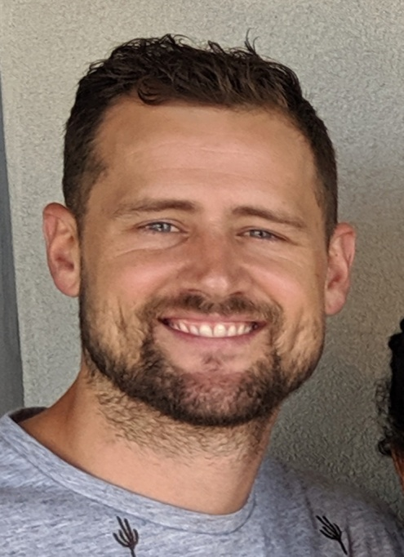
ANAFUND Scholarship Program Your association working for you
Congratulations!
Alex Washburn, 33
From Tucson, AZ
Junior at Mesa Community College for Landscape Horticulture
GPA 3.25
$1,850 Krantz Funds

Slide 50
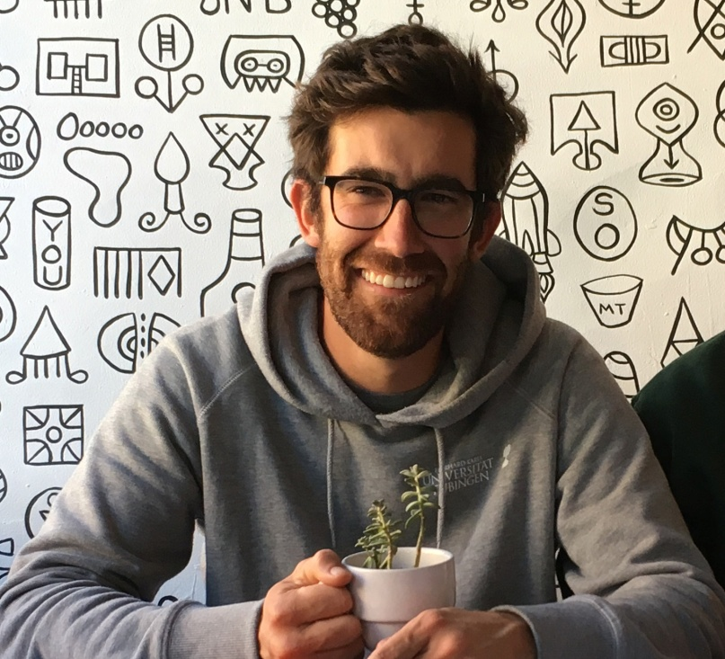
ANAFUND Scholarship Program Your association working for you
Congratulations!
Mario Nuno-Whelan, 33
From Tucson, AZ
Junior at the University of Arizona for a Masters of Landscape Architecture
GPA 4.0
$2,225 Hegeler and $275 Nixon Funds

Slide 51
ANAFUND Scholarship Program Your association working for you
Congratulations!
Penelope Cottrell, 30
From Tucson, AZ
Junior at the University of Arizona for a Masters of Landscape Architecture
GPA 4.0
$1,775 Douglas and $1,050 Vlachos Funds

Slide 52
ANAFUND Scholarship Program Your association working for you
Congratulations!
Alec Trevillian, 22
From Phoenix, AZ
Freshman at Arizona State University for Landscape Architecture
GPA 3.5
$2,900 Ladd Smith Funds

Slide 53
ANAFUND Scholarship Program Your association working for you
Congratulations!
Emma Troub, 19
From Buckeye, AZ
Freshman at the University of Arizona for Ag Tech Mgmt and Education
GPA 3.9
$2,000 Williams Fund

Slide 54
ANAFUND Scholarship Program Your association working for you
ANAFUND
Congratulations recipients and thank you to the families who make these funds possible!

Slide 55
ANAFUND Scholarship Program Your association working for you
ANAFUND
And thank you to our ANAFUND Board of Trustees:
Cindy Riding, Chairman
Don Waltemeyer
Phil Hemminghaus
Robin Franklin
Jean McGrath
Ken Williams
John Augustine
Niko Vlachos
Bart Worthington
Brett Cameron
Tim Businda
Jimmy Fox
Jay Harper
Dan Scholl

Slide 56
ANAFUND Scholarship Program Your association working for you
ANAFUND
And thank you to our ANAFUND Scholarship Committee:
Cindy Riding, Chairman
Jean McGrath
Bart Worthington
Aaron Allen

Slide 57
ANAFUND Scholarship Program Your association working for you
ANAFUND
Special Thank You To Our Named Family Funds!
Williams Family
Augustine Heritage
Ladd Smith
Hegeler
Krantz
Cliff & Marilyn Douglas
Hemminghaus Family
Kazan
Vlachos Family
Kolley

Slide 58
ANAFUND Scholarship Program Your association working for you
ANAFUND
Special Thank You To Our Named Family Funds!
Ron & Maureen Gass
Wheat
Farber
Becker Family
AzASLA
Cusma
O’riley
Waltemeyer Family
Jones
Cindy Riding

Slide 59
ANAFUND Scholarship Program Your association working for you
ANAFUND
Special Thank You To Our Named Family Funds!
Harper
Nixon
McGrath
Greg Augustine
Berridge

Slide 60
Your association working for you
Southwest Horticulture
Published six times a year, Southwest Horticulture is available online at www.azna.org and mailed to all members.

Slide 61
Your association working for you
Plant Something
ANA’s consumer promotional tag line-make sure to use it!

Slide 62
Your association working for you
ACNP Online!
The ACNP Program is now available ONLINE at mcorcollege.com/aznursery. Contact the office to schedule your test.

Slide 63
Your association working for you
2018 Membership Directory
Go to our website at www.azna.org or stop by our office to pick up a copy of the 2019 ANA Membership Directory. Thank you all for your continued membership of the association!

Slide 64
Your association working for you
ANA Eupdates
If you are not receiving our eupdates, please let Shayla know so you can stay updated on what your association is up to!

Slide 65
Your association working for you
ANA Staff
In case you didn’t know, here’s your ANA staff team:
Cheryl Koury,
Executive Director
Shayla Hughes,
Communication and Education Director
Bart Worthington, Bookkeeper

Slide 66
Your association working for you
Thank You!
Thank you 2019 Board of Directors:
Officers ANAFUND Representative
Les Shipley, President, Civano Nursery Cindy Riding, AZ Best Real Estate
Tyler Francis, President-Elect, Francis Roses
Roger Ramsey, Treasurer, Ewing Irrigation
Don Waltemeyer, Past-President, Treeland Nurseries
Board Members
Christine Fortman, Berridge Nurseries Ex-Officio Member
Jeff Grass, Mtn. States Wholesale Nursery John Caravetta, AZ Dept. of Agriculture
Kevin Salamandra, Arid Zone Trees
Patty Beuerlein, GRO-WELL Brands
Matt Bigham, Western Growers
Jay Harper, The Farms Choice Fertilizer

Slide 67
Your association working for you
2020 Board of Directors
Officers ANAFUND Representative
Tyler Francis, President, Francis Roses Cindy Riding, AZ Best Real Estate
Christine Fortman, President-Elect, Berridge Nurseries
Roger Ramsey, Treasurer, Ewing Irrigation
Les Shipley, Past-President, Civano Nursery
Board Members Ex-Officio Member
Jeff Grass, Mtn. States Wholesale Nursery John Caravetta, AZ Dept. of Agriculture
Kevin Salamandra, Arid Zone Trees
Patty Beuerlein, GRO-WELL Brands
Matt Bigham, Western Growers
Jay Harper, The Farms Choice Fertilizer
Don Waltemeyer, Treeland Nurseries

Slide 68
Your association working for you
Thank You Sponsors!
Jim Rupe

Slide 69
Your association working for you
Thank You!
Miggy ‘n Stan for the music this evening!

Slide 70
Your association working for you
Thank You!
And thank YOU members for your continued support. We are your association and would not be what we are without your membership!

